Slide 1
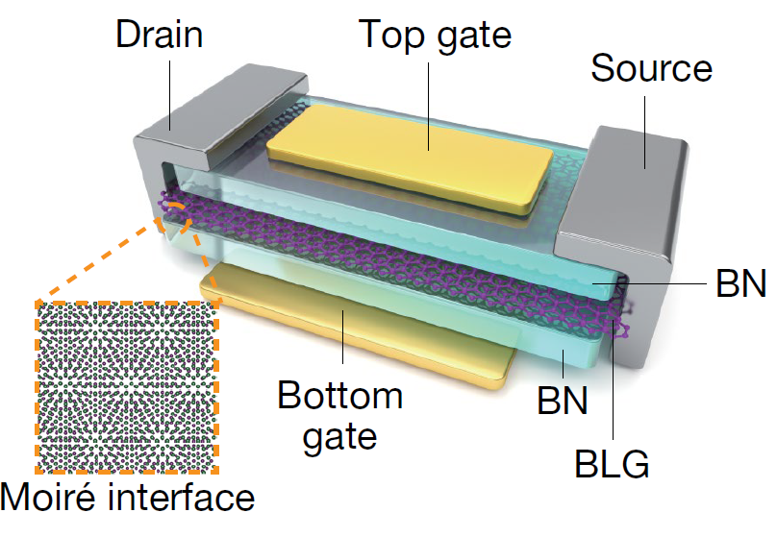
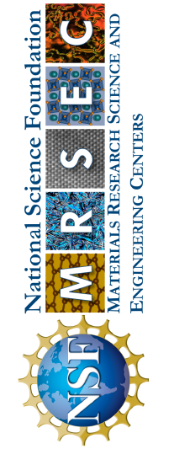
Northwestern Univ MRSEC
DMR-1720139
Moiré Synaptic Transistor with Room-Temperature Neuromorphic Functionality
IRG-1, Northwestern University MRSEC
Moiré quantum materials host exotic electronic phenomena through enhanced internal Coulomb interactions in twisted two-dimensional heterostructures. When combined with the exceptionally high electrostatic control in atomically thin materials, moiré heterostructures have the potential to enable next-generation electronic devices with unprecedented functionality. However, despite extensive exploration, moiré electronic phenomena have thus far been limited to impractically low cryogenic temperatures, thus precluding real-world applications of moiré quantum materials. In recent work from Northwestern University MRSEC IRG-1, room-temperature operation of a low-power moiré synaptic transistor based on an asymmetric bilayer graphene/hexagonal boron nitride moiré heterostructure has been achieved. The asymmetric moiré potential gives rise to robust electronic ratchet states, which enable hysteretic, non-volatile injection of charge carriers that control the conductance of the device. The asymmetric gating in these dual-gated moiré heterostructures realize diverse bio-realistic neuromorphic functionalities that are ideally suited for efficient compute-in-memory designs and edge hardware accelerators for artificial intelligence and machine learning.
Nature, 624, 551 (2023).
Schematic of the moiré synaptic transistor, which consists of bilayer graphene (BLG) sandwiched by two hexagonal boron nitride (BN) layers with different rotational angles that produces an asymmetric moiré potential with room-temperature neuromorphic functionality.
Notes:
What Has Been Achieved: Here we report the experimental realization of a moiré synaptic transistor (MST) based on bilayer graphene (BLG)/hexagonal boron nitride (BN) moiré heterostructures, which presents two main advantages over existing non-volatile memories. First, the intrinsic ratcheting states are realized by stacking BN and BLG layers with specific stacking orders and alignment angle, which result in ferroelectricity from the electronic degrees of freedom. In contrast, traditional memristors and ferroelectric memories rely on ion migration and atomic displacement, and often require specialized growth techniques, annealing, active layers, and forming processes to intentionally create defective states or multiple ferroelectric domains in switching layers. With their underlying ratcheting mechanism, MSTs possess low power consumption (20 pW), show high endurance and retention of multiple states, and are compatible with scalable fabrication in crossbar architectures. Second, hysteretic electronic ratcheting results in room-temperature tuning of non-volatile conductance states with unique gate-tunable synaptic plasticity. This reconfigurable synaptic plasticity enables diverse neuromorphic computing applications such as spike-based perceptrons and spatiotemporal-based tempotrons.
Importance of the Achievement: The unique asymmetry of the dual-gated BLG/BN moiré heterostructure allows for bio-realistic bidirectional synaptic threshold sliding using voltage as a state variable instead of frequency, which is preferred for hardware integration and is not possible with competing devices without additional circuit elements. These distinctive features imply that MSTs possess clear advantages over existing non-volatile memories for mimicking biological homeostatic mechanisms and input-specific adaptation that can accelerate emerging neural network applications.
How is the achievement related to the IRG, and how does it help it achieve its goals? Northwestern University MRSEC IRG-1 is focused on understanding and utilizing novel electronic properties in mixed-dimensional heterostructures. The MST advances these goals by exploiting the interplay between the zero-dimensional immobile states in the top graphene layer induced by the aligned BLG/BN moiré potential and the two-dimensional delocalized states in the bottom graphene layer. This mixed-dimensionality results in unprecedented ratcheting charge transport that is of high utility for advanced neuromorphic functionality.
Where the findings are published: X. Yan, Z. Zheng, V. K. Sangwan, J. H. Qian, X. Wang, S. E. Liu, K. Watanabe, T. Taniguchi, S.-Y. Xu, P. Jarillo-Herrero, Q. Ma, and M. C. Hersam, “Moiré synaptic transistor with room-temperature neuromorphic functionality,” Nature, 624, 551 (2023).

