Slide 1
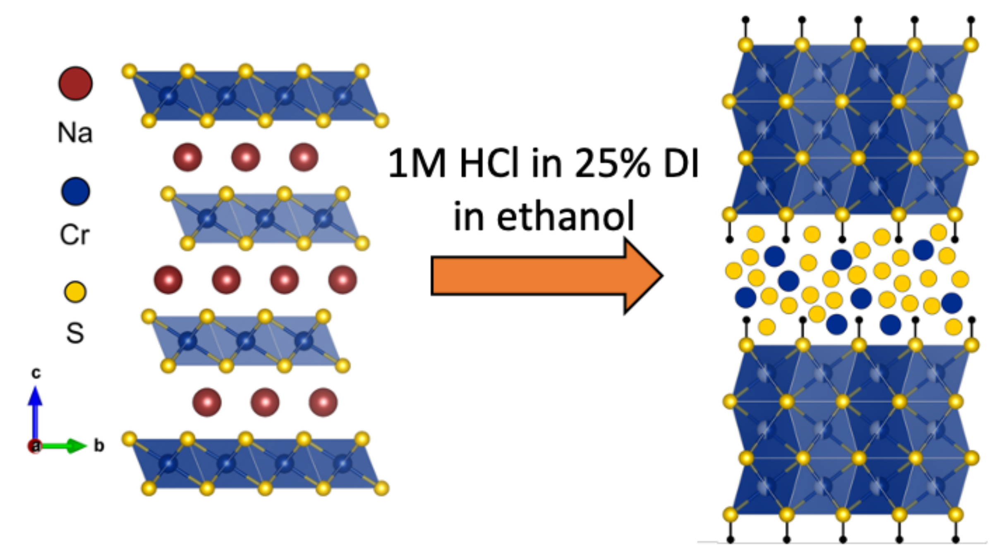
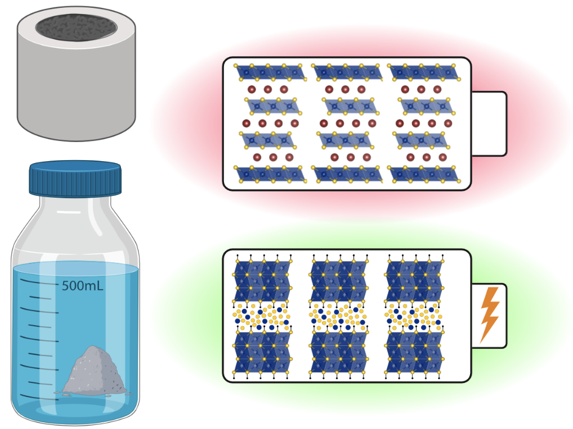
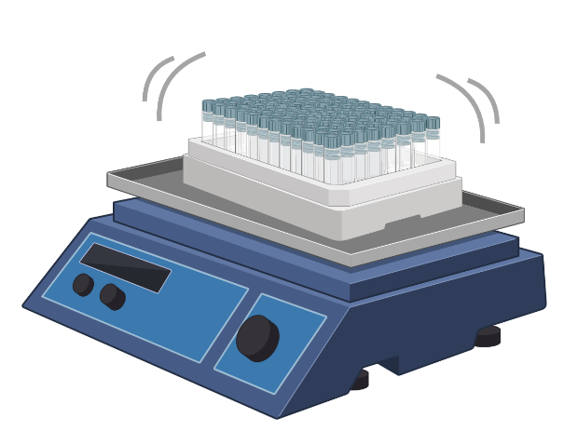
Princeton University MRSEC
DMR-2011750
Unlocking High Capacity and Fast Na+ Diffusion of HxCrS2 by Proton-Exchange Pretreatment
Major contributors: J. W. Stiles¹, C.B. Arnold¹, L. M. Schoop¹ (¹Princeton University)
Interest in sodium ion batteries is on the rise due to the relative abundance of sodium compared with lithium
Proton-exchange of NaCrS₂ results in a new biphasic structure: H_{x}CrS₂
H_{x}CrS₂ demonstrates faster Na+ diffusion and higher capacities than NaCrS₂
J. W. Stiles¹, A. L. Soltys¹, X. Song¹, S.H. Lapidus², C.B. Arnold¹, L. M. Schoop¹, Adv. Materials (2023), 2209811
Open access: doi.org/10.26434/chemrxiv-2022-9vlcf
¹Princeton University, USA, ²Argonne National Lab, USA
Notes:
We have demonstrated that acid pre-treatment of NaCrS₂ to form a new phase we call H_{x}CrS₂ results in significant improvements to the material’s performance as a sodium battery electrode. Acid exchange to remove sodium from NaCrS₂ is accompanied by a phase transformation to a biphasic structure with alternating amorphous and crystalline layers. This unique structure allows for faster diffusion of Na⁺ and results in higher capacities that can be sustained over longer cycling lifetimes. Specifically, our new material features a capacity of 728 mAh/g which is maintained throughout cycling and is nearly double the reversible capacity of NaCrS₂ in the same potential region. H_{x}CrS₂ also features a Na⁺ diffusion constant on the order of 10,000 times faster than in NaCrS_{2.}
J. W. Stiles¹, A. L. Soltys¹, X. Song¹, S.H. Lapidus², C.B. Arnold¹, L. M. Schoop¹, Adv. Materials (2023), 2209811
Open access: doi.org/10.26434/chemrxiv-2022-9vlcf

