Slide 1
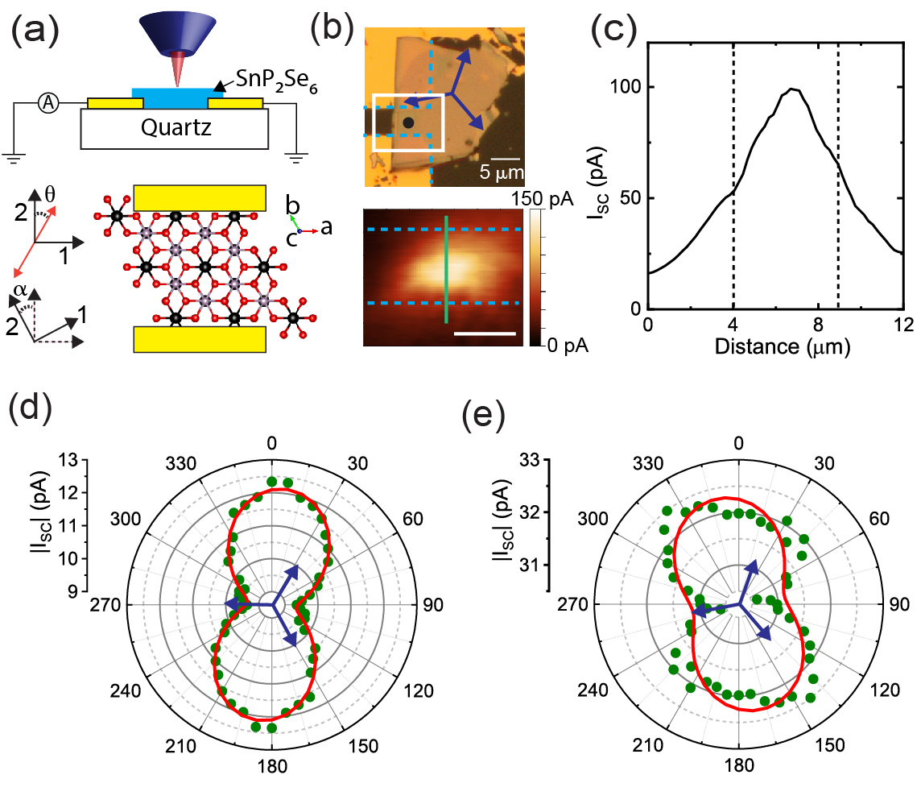

Northwestern MRSEC
DMR-1720139
Discovery of Intrinsic Bulk Photovoltaic Effect in 2D SnP₂Se₆
IRG-1, Northwestern University MRSEC
Conventional semiconductor heterojunctions and homojunctions are foundational building blocks of optoelectronic devices including solar cells and light-emitting diodes. Non-centrosymmetric two-dimensional (2D) materials enable the engineering of mixed-dimensional heterostructures with complex optoelectronic properties, such as a polarization-dependent photoresponse. A 5-PI collaboration within the Northwestern University MRSEC discovered a strong ‘bulk’ intrinsic photovoltaic effect (BPVE) in 2D SnP₂Se₆, a van der Waals chiral (R3 space group) semiconductor. The strong BPVE arises from the combination of high carrier mobility and non-centrosymmetric crystal structure, and the response can be tuned by varying the angle between the crystal and the electrodes as well as the angle of the linearly polarized light. The novel symmetry-dependent photoresponse and the high carrier mobility of SnP₂Se₆ present diverse opportunities for constructing mixed-dimensional heterojunctions with tailorable optoelectronic properties.
Science Advances, 10, eado8272 (2024).
Polarization-dependent photocurrent reveals bulk photovoltaic effect.
Top Left: Polarized light is used to illuminate a thin crystal of SnP₂Se₆. Bottom Left: Top-view schematic of the crystal showing its orientation with respect to the gold metal electrodes and the polarization direction θ. α is the rotation of the crystal. Right: Variation of the photocurrent with angle due to the bulk photovoltaic effect. Red lines are fits to a phenomenological model.
Notes:
What Has Been Achieved: A new layered chiral chalcophosphate, SnP₂Se₆, has been synthesized. SnP₂Se₆ is a van der Waals chiral (R3 space group) semiconductor, which shows a bulk photovoltaic effect and photocurrent generation without an applied voltage due to the crystal symmetry. The short-circuit current density arising from the bulk photovoltaic effect exceeds that of ferroelectric insulators by 1-3 orders of magnitude. In addition, phototransistors show a fast response time of less than 5 μs with responsivity exceeding 10⁵ A/W and detectivity exceeding 10¹⁴ Jones, making it the highest gain van der Waals photodetector operating at this speed.
Importance of the Achievement: The synthesis of new layered compounds is a promising pathway to create materials with novel properties due to the varied strength of bonding interactions along different directions and potential for tuning properties with variations in layer stacking. Recently, researchers have observed unique electrical and optical properties in various layered thiophosphate and selenophosphate crystals, and their highly tunable chemistry makes them promising for realizing superlative properties. In particular, SnP₂Se₆ exhibits a compelling combination of fundamental characteristics, including a high electron mobility, moderate band gap, and chiral symmetry, which produce a strong polarization-dependent photoresponse. The photoresponse arises from symmetry and does not require an applied bias, suggesting the possibility of ‘self-powered’ devices.
How is the achievement related to the IRG, and how does it help it achieve its goals? A key goal of IRG-1 is to realize tunable responses to stimuli arising from the geometry and novel electronic structure of mixed-dimensional heterojunctions. The symmetry of 2D SnP₂Se₆ creates a polarization-dependent photoresponse even without the creation of a heterojunction, providing a useful design principle for the construction of mixed-dimensional heterojunctions with SnP₂Se₆ as a component. Embedding complex response functions within materials is one strategy to introduce qualitatively distinct or quantitatively superior performance characteristics in devices and circuits.
Where the findings are published: V. K. Sangwan, D. G. Chica, T.-C. Chu, M. Cheng, M. A. Quintero, S. Hao, C. E. Mead, H. Choi, R. Zu, J. Sheoran, J. He, Y. Liu, E. Qian, C. C. Laing, M.-A Kang, V. Gopalan, C. Wolverton, V. P. Dravid, L. J. Lauhon, M. C. Hersam, and M. G. Kanatzidis, “Bulk photovoltaic effect and high mobility in the polar 2D semiconductor SnP₂Se₆,” Science Advances, 10, eado8272 (2024).

