Slide 1
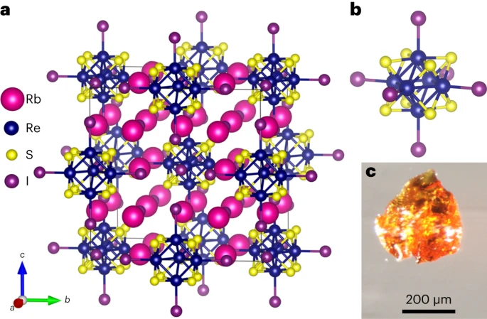
Northwestern MRSEC
DMR-1720139
Realization of the Light-Emitting Heteroanionic Chalcohalide Rb₆Re₆S₈I₈
IRG-2, Northwestern University MRSEC
A new photoluminescent rhenium chalcohalide cluster compound, Rb₆Re₆S₈I₈, with superlative optoelectronic properties has been developed.
This material shows strong potential for advanced light-emitting devices due to its high photoluminescent quantum yield and solution processability.
The development of Rb₆Re₆S₈I₈ supports the supports the mission of NU-MRSEC IRG-2 to realize new heteroanionic materials with uniquely tailored properties.
Nature Materials, 23, 230 (2024).
(a) Crystal structure of the heteroanionic chalcohalide Rb₆Re₆S₈I₈. (b) Isolated [Re₆S₈I₆]⁴⁻ cluster. (c) Rb₆Re₆S₈I₈ single crystal.
Notes:
What Has Been Achieved: A new photoluminescent rhenium chalcohalide cluster compound, Rb₆Re₆S₈I₈, with excellent optoelectronic properties has been developed.
.
Importance of the Achievement: This material shows strong potential for advanced light-emitting devices due to its high photoluminescent quantum yield and solution processability.
How is the achievement related to the IRG, and how does it help it achieve its goals? The development of Rb₆Re₆S₈I₈ supports the mission of NU-MRSEC IRG-2 to realize new heteroanionic materials with uniquely tailored properties.
Where the findings are published: Laing, C. C.; Kim, D.; Park, J.; Shen, J. H.; Hadar, I.; Hoffman, J. M.; He, J. A.; Shin, B.; Wolverton, C.; Kanatzidis, M. G. . Nature Materials 2024, 23, 230-236.

