Slide 1
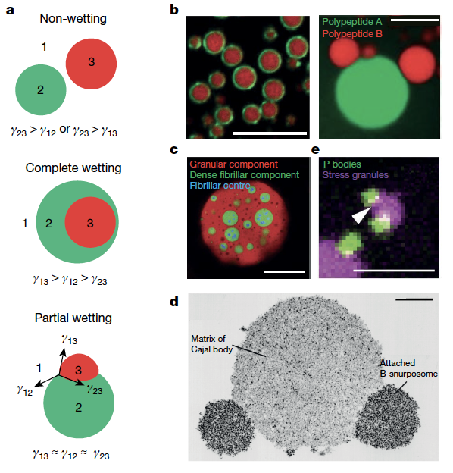
Princeton University MRSEC
DMR-2011750
Capillary forces and biomolecular condensates: Structure and function (IRG-B)
Major Contributor(s): C. Brangwynne* and H.A. Stone* (*Princeton U.)
In the Perspective, fundamental physical principles of capillarity, and many examples, are presented illustrating how capillary forces enable structuring multiphase condensates, as well as remodel and organize biological substrates, such as DNA, actin, microtubules, and membranes.
Capillarity in multiphase condensate organization: interfacial tension, and corresponding wetting phenomena, reorganize viscoelastic materials.
Published in Gouveia et al., “Capillary forces generated by biomolecular condensates,” Nature 609 (2022).
Notes:
What Has Been Achieved: The intracellular environment is a complex and crowded sea of biomolecules, buffeted by incessant motion from Brownian thermal fluctuations and biological activity. Cellular function is achieved by bringing order to this environment, in large part through sub-compartmentalization into a spatially controlled and compositionally defined organization. Historically, these compartments were thought of almost exclusively as membrane-bound structures, but recent work has highlighted the importance of membraneless organelles, also known as biomolecular condensates, which form through phase transitions, including liquid–liquid phase separation. Some of the dozens of examples of such protein and nucleic acid-rich condensates include P granules, nucleoli, stress granules, the pyrenoid and DNA repair foci.
Importance of the Achievement: How is the achievement related to the IRG, and how does it help it achieve its goals? In this Perspective published in Nature, IRG-B researchers (Brangwynne and Stone) present the physical principles of capillarity, including examples of how capillary forces structure multiphase condensates and remodel biological substrates. As with other mechanisms of intracellular force generation, for example, molecular motors, capillary forces can influence biological processes. Identifying the biomolecular determinants of condensate capillarity represents an exciting frontier, bridging soft matter physics and cell biology. The material science of biological condensates form a major part of the soft matter science and engineering studied in IRG-B.
Where the findings are published: Bernardo Gouveia, Yoonji Kim, Joshua W. Shaevitz, Sabine Petry, Howard A. Stone and
Clifford P. Brangwynne, “Capillary forces generated by biomolecular condensates,” Nature, Volume 609 (2022).

