Slide 1
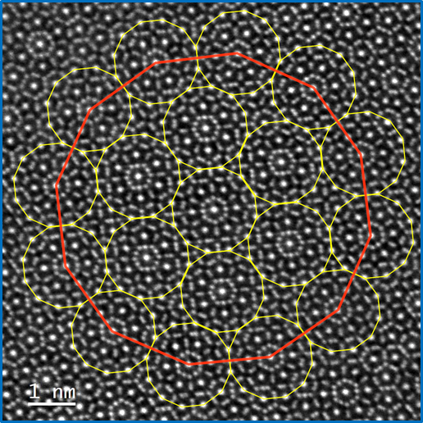
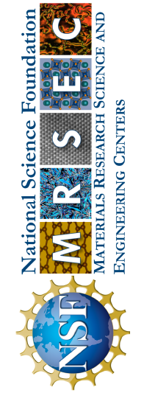
Princeton University MRSEC
DMR-2011750
The Imaging and Analysis Center supported by PCCM
Nan Yao, Director, Imaging and Analysis Center, Princeton
The Imaging and Analysis Center (IAC) supported by PCCM is a world-leading facility for materials characterization. Its central mission is the education, research, and training of students at Princeton University and beyond. The IAC also collaborates with researchers in industry and other academic institutes.
The IAC’s advanced instrumentation is open to all qualified users, whether from Princeton or outside. Recent IAC users include over 530 students and researchers from 18 departments and centers on campus. The IAC also supports more than ten regular courses annually and offer a full range of short courses.
In 2022, normal operations in the IAC were fully resumed. The IAC opens to graduate students, postdocs, undergraduates and outside users to perform research with support from 100% center staff operating in person. The award-winning course conducted in the IAC, MSE 505 - Characterization of Materials, had a record high enrollment of 52 students. The IAC conducted training courses (required for instrument access) in 34 topics with direct experimental demonstrations and hands-on instruction, ranging from basic sample preparation devices to high-end aberration-corrected transmission electron microscopes. In the past year, IAC has offered over 250 short courses with more than 500 students enrolled (all in-person) and provided service and support to over 230 research grants at Princeton. There are over 530 internal users (comprised of undergraduate students, graduate students, faculty, and postdoctoral researchers) and more than 51 outside users (from 30 industrial companies and two academic organizations, mainly through “assisted usage”) have worked in the IAC.
Image courtesy: G. Cheng, N. Yao, P. J. Steinhardt
Notes:
About the image: Natural quasicrystals, which are formed at high temperature and pressure when rocky bodies collide, were previously found only in meteorites and at atomic bomb test sites. In an article "Electrical discharge triggers quasicrystal formation in an eolian dune", published in the Proceedings of the National Academy of Sciences, Princeton researchers and collaborators have found a rare type of quasicrystal with 12-fold symmetry that defies typical crystallography patterns, in a piece of "fossilized lightning" found in Nebraska's Sandhills near a fallen power line. The discovery suggests mechanisms for forming quasicrystals in nature (on Earth and in space) and in the laboratory.
Link to the article: https://www.pnas.org/doi/abs/10.1073/pnas.2215484119

