Slide 1
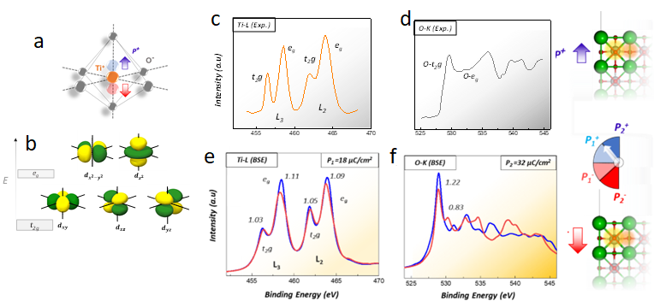
UC San Diego MRSEC
DMR-2011921
A Multiphysics Approach for the Self-Assembly of Nanocrystal Checkerboards
Pedram Abbasi, David Fenning, Tod Pascal, UC San Diego
IRG1 has developed a toolkit for carrying out simulated X-ray adsorption spectroscopy (XAS). XAS is a powerful technique for understanding the surface local structure and chemistry of complex interfaces at the nanoscale.
The team used XAS to understand the factors that contribute to changes in the electronic structure of ferroelectric BaTiO₃ thin films from first-principles. The team was able to map out the energy landscape for this complex material, both computationally and spectroscopically.
This work expands the team’s knowledge of how materials operate at the atomic level, providing a rigorous accounting for materials physics and chemistry, such as polarization-induced surface reconstruction.
(a) Schematic of TiO₆ octahedron within the BaTiO₃ tetragonal structure, (b) possible hybridized orbitals, (c,d) Experimental XAS spectra (e) Calculated Ti-L edge XAS (f) Calculated O K-edge XAS.
Nanoscale, 2023, 15(11), 5193-5200
Notes:
What Has Been Achieved: IRG1 has developed a toolkit for carrying out simulated X-ray adsorption spectroscopy (XAS). XAS is a powerful technique for understanding the surface local structure and chemistry of complex interfaces at the nanoscale. The team has reported on the factors the contribute to changes in the electronic structure of ferroelectric BaTiO3 thin films from first-principles, simulated X-ray adsorption spectroscopy (XAS). To calculate the XAS of this complex material computationally, the team employed two widely used approaches, with different ways of treating the XAS excitation, namely the many-body ΔSCF determinant and the GW/Bethe-Salpeter equation approaches.
Importance of the Achievement: The team used XAS to understand the factors that contribute to changes in the electronic structure of ferroelectric BaTiO3 thin films from first-principles. This is a complex material for the team is able to map out the energy landscape, computationally and spectroscopically.
How is the achievement related to the IRG, and how does it help it achieve its goals? This work expands the team’s knowledge how materials operate at the atomic level, providing a rigorous accounting for materials physics and chemistry, such as polarization-induced surface reconstruction.
Where the findings are published: Abbasi P, Fenning DP and Pascal TA*, "Investigation of local distortion effects on X-ray absorption of ferroelectric perovskites from first principles simulations", Nanoscale, 15 (11), 5193-5200, 2023.

