Slide 1
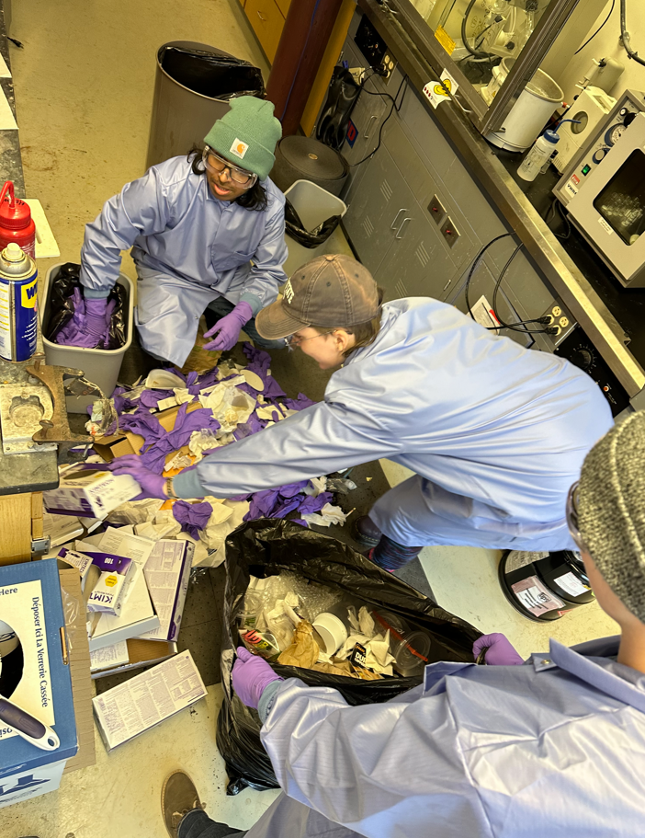
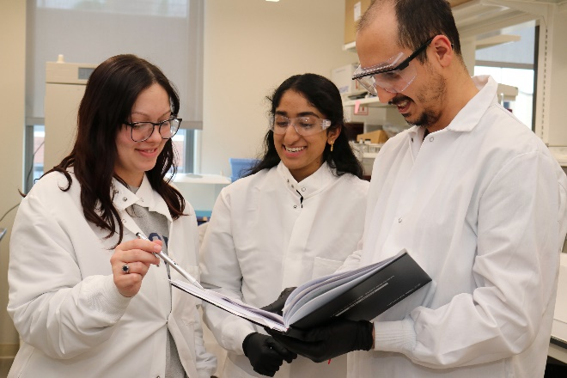
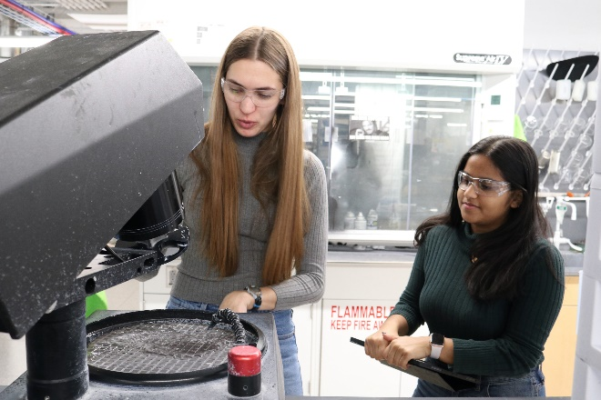
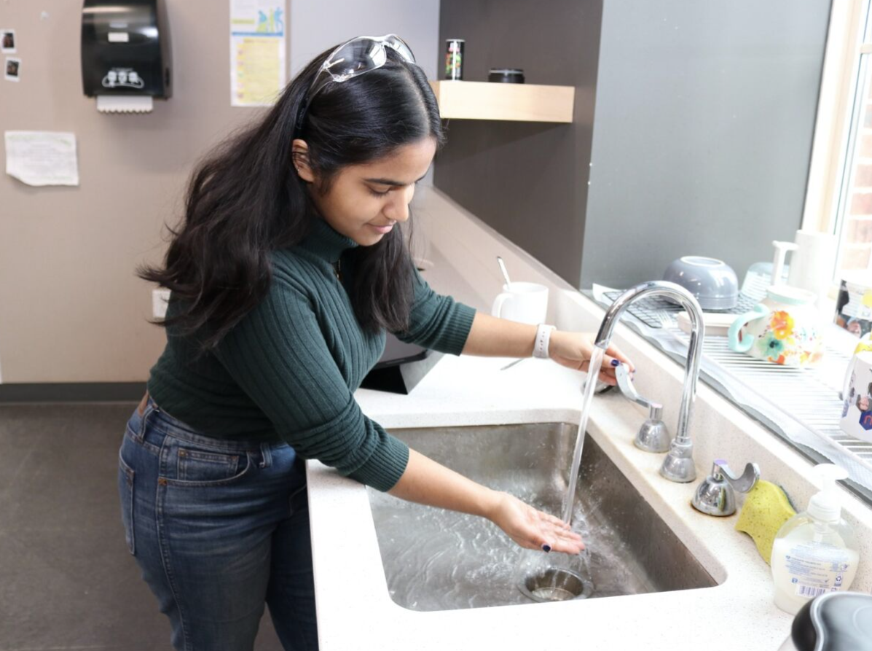
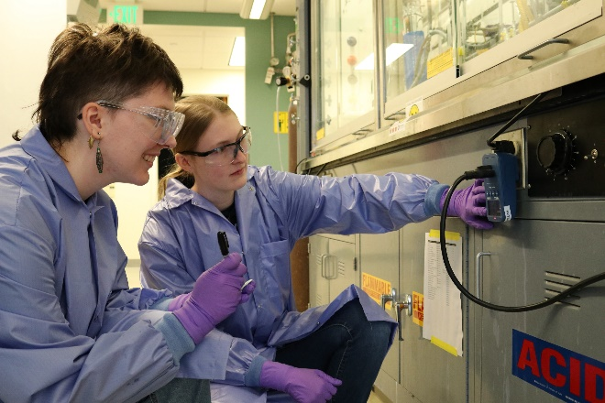
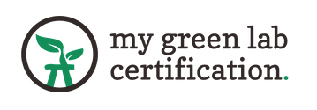
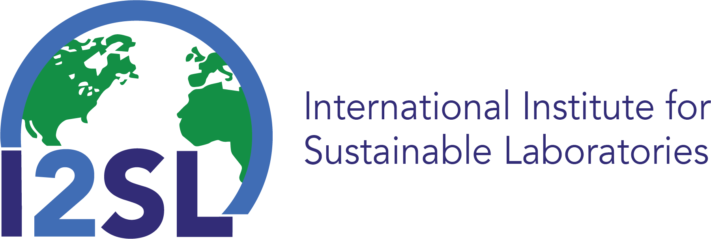
Penn State MRSEC
DMR-2011839
Sustainability efforts gain institutional support and international recognition
K. Dreyer, N. Alem, R. Schaak, K. Bailey, J. Rumery, PSU Sustainability
The MRSEC’s sustainability initiative for research labs expanded in its second year to 29 labs across Penn State University Park and six branch campuses. Over 400 researchers have been involved thus far. Labs completing My Green Lab certification can be paired with one of 17 undergraduate Sustainable Lab Ambassadors who apply their sustainability training to the lab setting through engaged scholarship. MRSEC Education Director Kristin Dreyer spearheaded the launch of this program and facilitates further institutional investment by Penn State Sustainability.
Quantitative operational impact data is captured by waste audits, plug load measurements, and water usage analysis.
The International Institute of Sustainable Laboratories awarded an Honorable Mention to Penn State’s program in 2023.
Expansion of the undergraduate Sustainable Lab Ambassador program enabled better capture of quantitative impact data while students gain valuable workforce skills.
“This is work that Penn State is committed to… from the success of our Sustainable Labs Program in making our research more sustainable and energy efficient to our commitment to decarbonization and achieving 100% greenhouse gas emissions reductions by 2035…”
– Penn State President Neeli Bendapudi, October 10, 2023
Notes:
What Has Been Achieved: Following the success of the first year’s pilot effort, the second year (2023–2024) included a much larger cohort of undergrad consultants (Sustainable Lab Ambassadors, SLAs) and demonstrated that their pairing with research labs has strong appeal and benefits to both undergraduates and participating labs. Fifteen out of 29 labs received SLA assistance while two returning SLAs serving as valuable peer mentors. Having experienced student leaders to support the much larger cohort of SLAs prompted an initiative to collect quantitative impact data. These efforts revealed a need for better tools and methods of collection, so that comparisons and extrapolations can be made with confidence. Nonetheless, the data collection effort strengthened relationships between consultants and their labs while building technical and interpersonal skills and set the stage for enhanced data collection efforts in the next year.
Importance of the Achievement: The second-year pilot revealed further potential to impact operations, laboratory culture, and student skill development. Growth in the number of paid SLAs paired with a variety of labs allowed the program’s leadership team the opportunity to assess the essential elements of a successful SLA and laboratory experience. For example, not all labs are appropriate for hosting an SLA and providing that student with a rich experience that applies their training, yet all labs benefit from programmatic support to help them stay on track, tap into Penn State information and resources, and make improvements to their lab operations. Lessons learned are helping to formulate a long-term strategic plan for staffing needs, programmatic activities and timelines, partnerships with mutually beneficial goals, and permanent funding.
How is the achievement related to the IRG, and how does it help it achieve its goals? This effort aligns directly with the Center’s focus on sustainability as its proposed education, outreach, and human resource development theme.
Where the findings are published: Efforts are not yet published in the research literature, but multiple news articles have been written about the program and the International Institute for Sustainable Laboratories (I2SL) recognized the program with an Honorable Mention award and an invited talk at their fall 2023 conference.

