Slide 1
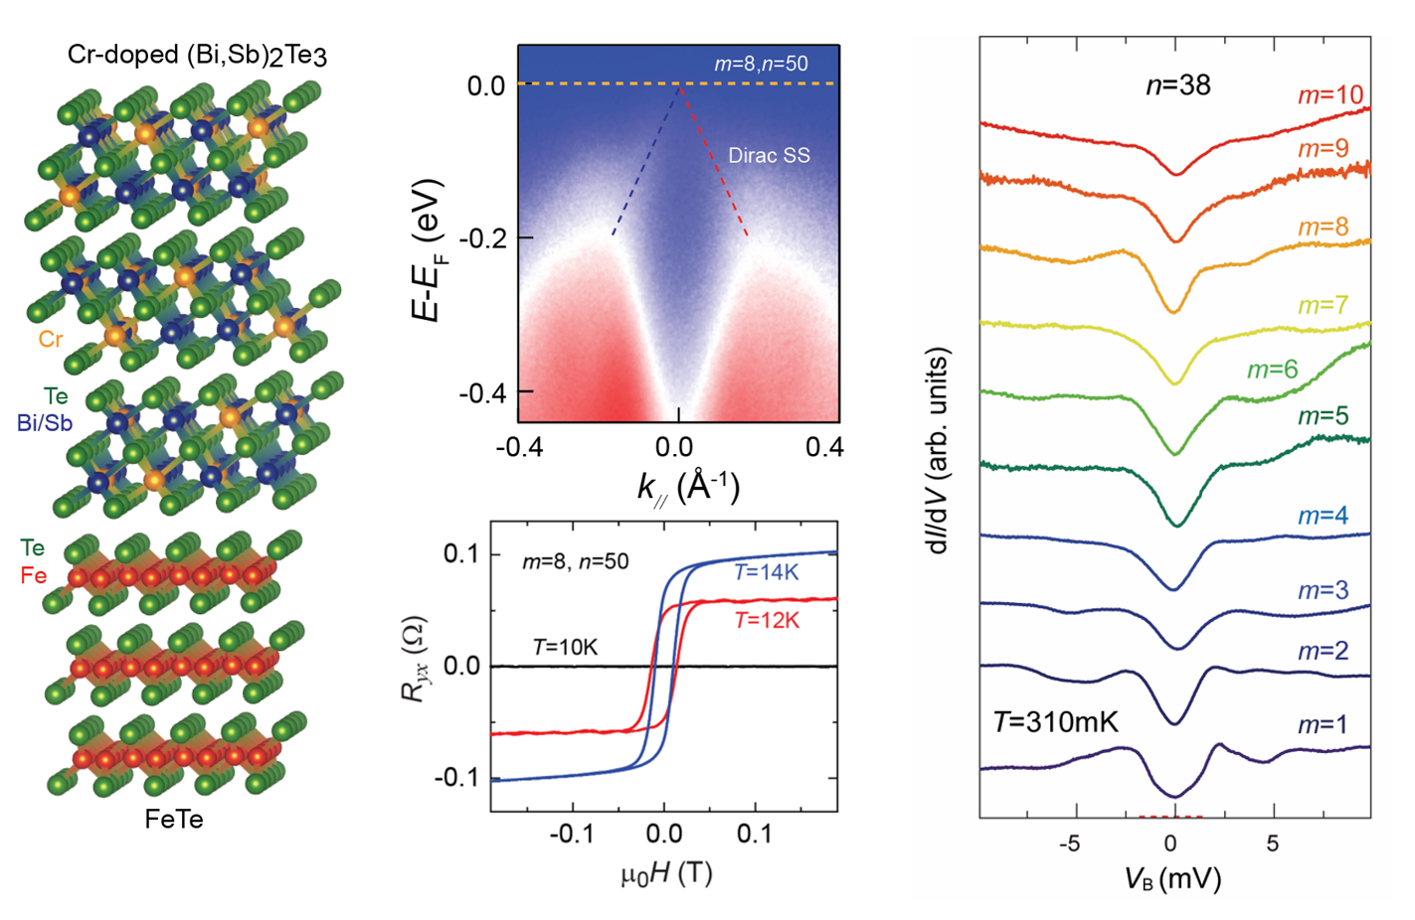
Penn State MRSEC
DMR-2011839
Interface-induced superconductivity in magnetic topological insulators
Nitin Samarth, Xiaodong Xu (UW), Weida Wu (Rutgers), Chao-Xing Liu, and Cui-Zu Chang
An IRG1 team employed molecular beam epitaxy to synthesize heterostructures stacking a ferromagnetic topological insulator with a quantum anomalous Hall state, Cr-doped (Bi, Sb)2Te3, and an antiferromagnetic iron chalcogenide, FeTe, with an atomically sharp interface. An unexpected phenomenon emerges: interface-induced superconductivity.
Electrical transport, reflective magnetic circular dichroism, magnetic force microscopy, and angle-resolved photoemission spectroscopy demonstrate the coexistence of superconductivity, ferromagnetism, and topological band structure.
These QAH/FeTe heterostructures with robust interface-induced superconductivity provide an ideal platform for the exploration of chiral topological superconductivity and Majorana physics and thus constitute an important step toward scalable topological quantum computation.
Left: MBE-grown Cr-doped (Bi,Sb)2Te3/FeTe heterostructures
Middle, right: Coexistence of superconductivity, ferromagnetism, and topological order. STM measurements confirm a superconducting proximity effect.
Yi et al., Science 383, 634 (2024)
$$T_{c} \sim 11K$$
Notes:
What Has Been Achieved: Discovery of interface-induced superconductivity formed by stacking together a ferromagnetic topological insulator and an antiferromagnetic iron chalcogenide.
Importance of the Achievement: The Cr-doped (Bi,Sb)₂Te₃/FeTe heterostructures with robust superconductivity and atomically sharp interfaces provide an ideal wafer-scale platform for the exploration of chiral topological superconductivity and Majorana physics, constituting an important step toward scalable topological quantum computation.
How is the achievement related to the IRG, and how does it help it achieve its goals? The research team benefits from close collaboration within the IRG. The experimentalists have investigated a hybridized structure consisting of two non-superconducting magnetic materials. The heterostructure displays co-occurrence of superconductivity, ferromagnetism, and topological order in the magnetic topological insulators. Theory shows that this combination of properties makes the heterostructure a promising platform for observing chiral topological superconductivity.
Where the findings are published: Yi et al., Science 383, 634 (2024)
https://www.science.org/doi/10.1126/science.adk1270

