Slide 1
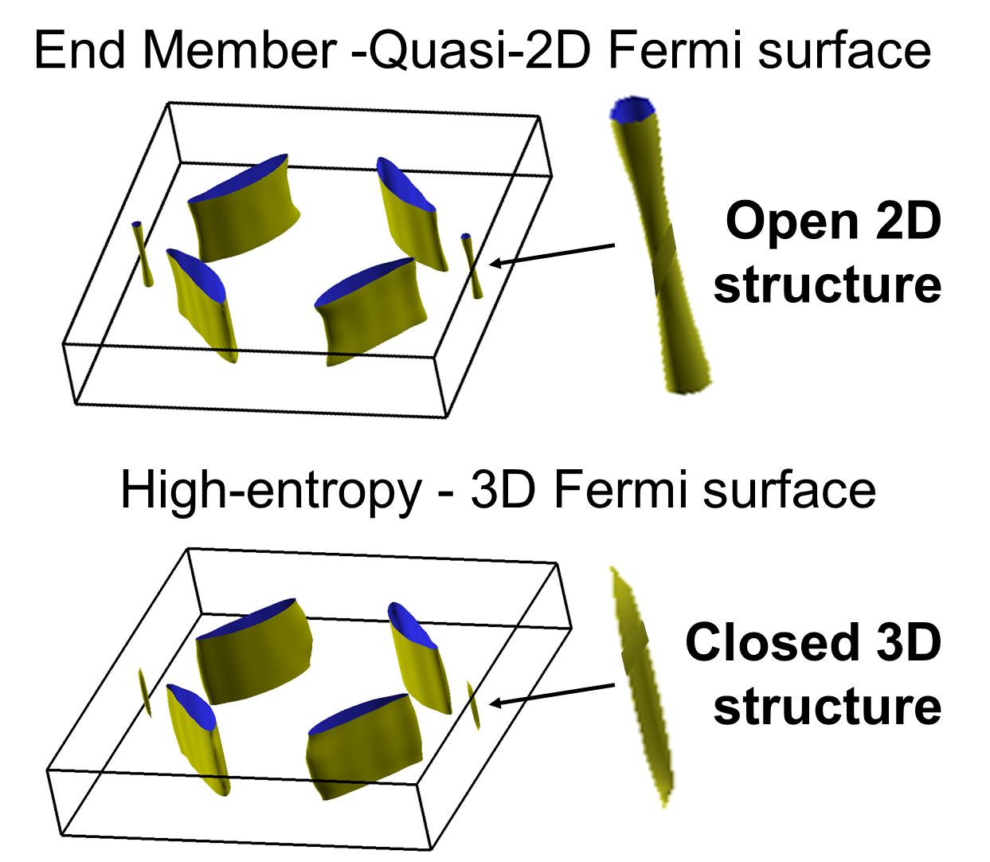
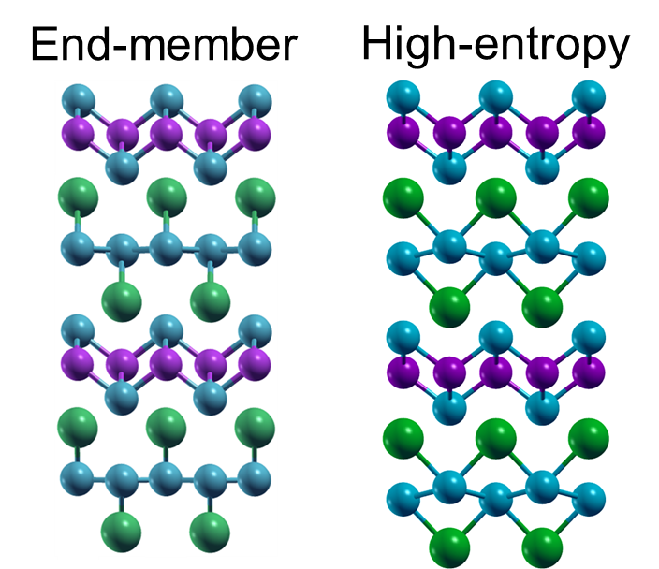
High-entropy engineering of the crystal and electronic structures in a Dirac material
Center for Nanoscale Science
DMR-2011839
Z. Mao, I. Dabo, C.-Z. Chang, V. Gopalan, N. Alem
Quantum materials have the potential to revolutionize technologies ranging from sensing to telecommunication and computation. However, advancement has been limited by the development of topological and Dirac materials. IRG2 researchers demonstrated a novel and widely applicable strategy to engineer relativistic electron states to develop such materials through a high-entropy approach.
The Dirac states of single crystalline (Ca,Sr,Ba,Eu.Yb)MnSb₂ Dirac semimetal were found to differ in character from those of its end-members. While the end-member compositions host quasi-2D Fermi surfaces, that of the high-entropy phase is quasi-3D. The sharing of the high-entropy sublattice by multiple species distorts the crystal structure locally, giving rise to a 3D Fermi surface.
Shubnikov–de Haas oscillations measurements were performed to determine the aspect ratio of the Fermi pocket. First-principles calculations validated these measurements and supported the proposed mechanism underpinning the engineering of the electronic structure.
Left: Diagram of the undistorted crystal structure typical of the end members and the distorted structure of the high entropy phase. Note the corrugation of the Sb layers (blue).
Right: Fermi surface of the undistorted end members and the distorted high entropy structure. Note the formation of a closed Fermi pocket in the latter.
Notes:
What Has Been Achieved: The synthesis and measurement of single crystals of high-entropy antimonides exhibiting Dirac stated differing in character from those of the end members of the composition range considered. These findings create a foundation for an expanded palette of IRG2 research activities.
Importance of the Achievement: High-entropy formulation distorts crystal structure at the local level altering the character of Dirac states.
How is the achievement related to the IRG, and how does it help it achieve its goals? One of the guiding high-entropy value propositions of IRG2 is that many-cation oxides with high solubility exhibit high crystalline fidelity while exhibiting a broad spectrum of local structures with great chemical diversity which is difficult or impossible to replicate in low-entropy systems. In the present case, these different local distortions control the dimensionality of the Fermi surface.
Where the findings are published: Laha, A., Yoshida, S., Marques dos Santos Vieira, F. et al. High-entropy engineering of the crystal and electronic structures in a Dirac material. Nat Commun 15, 3532 (2024). https://doi.org/10.1038/s41467-024-47781-9

