Slide 1
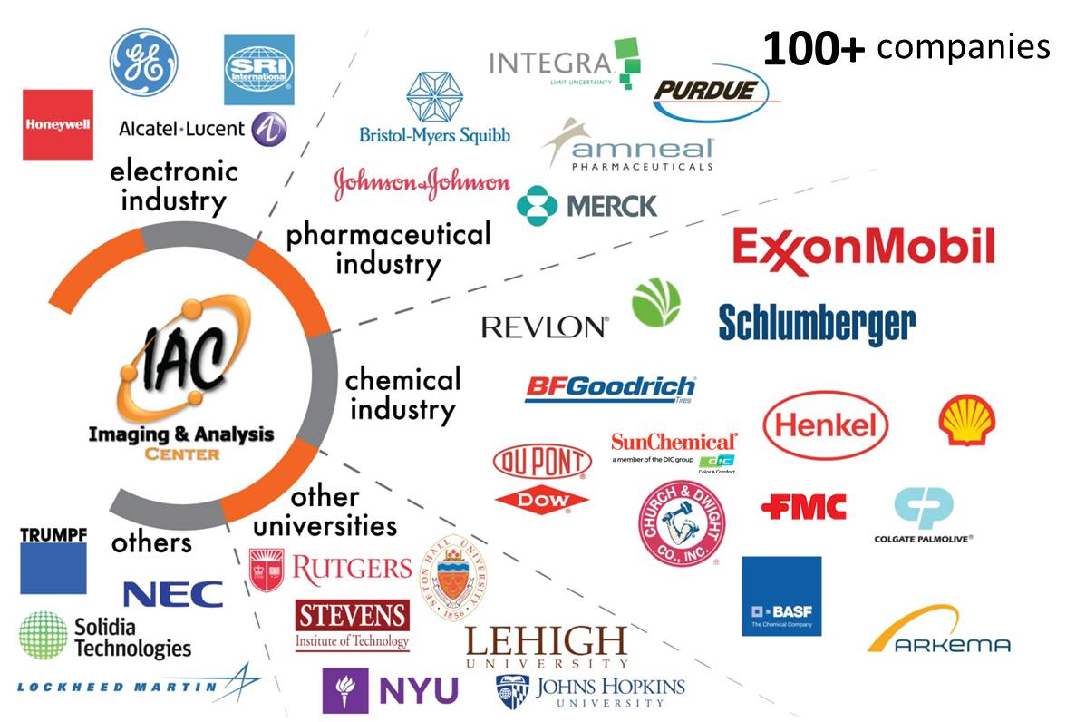
The Imaging and Analysis Center has long standing partnership with industry and other institutions
Princeton Center for Complex Materials: DMR-1420541
Nan Yao, 2017
The Imaging and Analysis Center (IAC) supported by PCCM is a world-leading facility for materials characterization. It is a critical resource to our industrial user community. The advanced instrumentation and expertise in the IAC provide ultimate opportunity for us to actively interact with industrial scientists. IAC conducts a series of short courses (required for instrument access), which involve direct experimental demonstrations and hands-on instruction, ranging from basic sample preparation devices to high-end electron microscopes. These 2-6 hour courses are offered regularly and frequently, every month, and are open to all industrial scientists. 8 industry organizations have joined IAC this past year including Gemological Institute of America, Inc., EAG Laboratories, Electronic Material Analysis, Integra Life Sciences, Kashiv Pharma LLC, etc. There have been over 700 industrial scientists from more than 100 companies utilized instruments in the IAC.
Princeton University
We have helped industrial partners to many innovations and new product developments. We would like to continue our efforts of developing IAC as an engine of education, innovation and economic growth.

