Slide 1
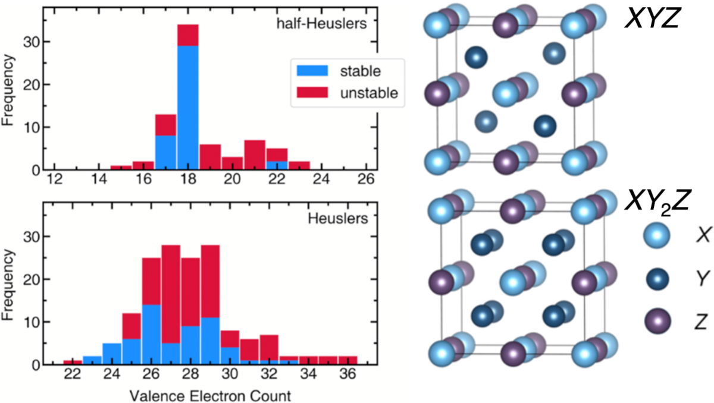
UC Santa Barbara MRSEC
DMR-1720256
Heusler Compounds: To Alloy or Not to Alloy?
Justin Mayer and Ram Seshadri (IRG-1)
Rules for the creation of alloys within the family of Heusler compounds, which are ordered compounds formed between metals, have been broadly formulated.
Heusler compounds are important functional materials, used for their magnetic and thermoelectric properties. These rules will help in designing new materials with optimized functionality.
The results directly support the goals of IRG-1 Magnetic Intermetallic Mesostructures since the controlled formation of single-phase and mesostructured magnetic Heusler materials is central to the project.
Stability of XYZ half-Heusler and XY₂Z Heusler compounds as a function of their valence electron counts. On the right are the unit cells depicting the structures of these compounds.
Notes:
What Has Been Achieved: Rules for when two Heusler intermetallics will or will not alloy have been postulated. These rules are not obvious and do not follow the simple and well-known Hume-Rothery prescription.
Importance of the Achievement: Half-Heusler (XYZ) and Heusler (XY2Z) phases are some of the most important intermetallic compounds and alloys with applications ranging from superconductivity and magnetism to topological materials, and applications in high-strength alloys and as thermoelectrics. Many of these applications are controlled by alloying Heusler compounds, but the rules for such alloying have not been clear. Phase separation—and conversely, the propensity for solid-solution formation—in these compounds has been studied here from extensive first-principles electronic-structure-based modeling. Alloying between distinct pairs of half-Heusler and Heusler compounds is possible at accessible processing temperatures when the two end-members are either isoelectronic or metallic. The formation of a band gap in semiconducting half-Heusler compounds is associated with significant stabilization. Attempts to create solid solutions with a semiconducting half-Heusler compound would lead to phase separation across the tie line because of the energy penalty associated with filling states in the gap. The alloying between two Heusler compounds, however, is expected even when the electronic behaviors of the end-members differ—clearly demonstrating the distinction between the underlying bonding within half-Heuslers and Heuslers: Half-Heuslers are well-defined intermetallics, whereas Heuslers tend to behave in a manner more in line with conventional alloys. The simple proxy related to electronic structure developed here differentiates Heusler and half-Heusler compositions that truly alloy from those that phase separate, aiding in the pursuit of reliable predictions for new materials.
How is the achievement related to the IRG, and how does it help it achieve its goals? IRG-1 addresses the broad domain of functional intermetallics including Heusler compounds which are the fruit-flies of functional intermetallics. The goal of the IRG is broadly, to control the response of the functional intermetallics, including their magnetism, which this work directly addresses.
Where the findings are published: Electron count dictates phase separation in Heusler alloys, J. A. Mayer and R. Seshadri, Phys. Rev. Mater. 6 (2022) 054406. DOI: 10.1103/PhysRevMaterials.6.054406

