Slide 1
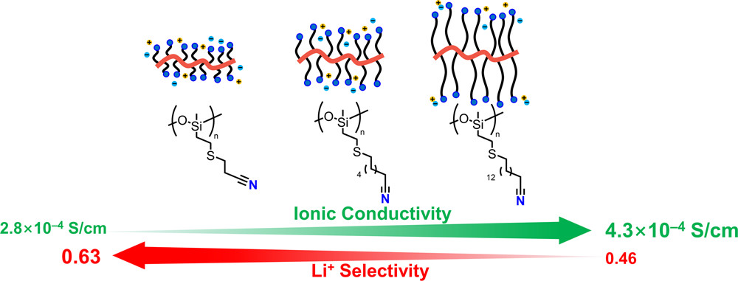
UC Santa Barbara MRSEC
DMR-1720256
High-Performance Polymer Solid Electrolytes
Raphaële Clément, Javier Read de Alaniz, and Rachel Segalman (IRG-2)
New lithium-ion transporting polymers, suitable for use as solid electrolytes in lithium ion batteries have been developed based on controlling the dielectric properties of polymers and details of the polymer architecture.
Many lithium-transporting polymers, which could play a central role in the future of solid-state lithium batteries, suffer from poor lithium conductivity, even if the total conductivity could be high due to the counterions moving. MRSEC IRG-2 researchers have devised strategies to ensure that it is the lithium that moves, making these materials useful.
The results directly support the goals of IRG-2 as they use rational design principles to develop useful polymers that are inspired by ionic liquids.
Controlling functional groups and polymer architectures allows the relative amount of lithium ions transported (the transference number) to be enhanced without much detriment to the total ionic conductivity.
Notes:
What Has Been Achieved: Enhancing the solubility of lithium in polymers enhances ionic conductivity but often at the expense of poor lithium ion transport and high(er) anion transport which is not useful. Here a strategy has been devised to ensure that high conductivity with a large lithium transport contribution can be accomplished with the proper choice of functional groups on the polymer. These materials could be useful as the solid electrolyte in lithium-ion batteries.
Importance of the Achievement: In polymer electrolytes, conduction is achieved through the dissolution and subsequent transport of the lithium cation and organic anion, yet only lithium transport (dictated by the transference number) provides useful current between the two electrodes. A polysiloxane-based polymer electrolyte grafted with cyano-containing side chains that are deliberately introduced to enhance total ionic conductivity while retaining a high transference number for lithium ions. The cyano groups provide the polymer high dielectric permittivity which aids fast lithium transport as confirmed by a number of experimental techniques. These results demonstrate the vast potential of nonpolar flexible polymers grafted with polar side chains as host materials for PEs.
How is the achievement related to the IRG, and how does it help it achieve its goals? IRG-2 is all about using the principles of diffuse charges in ionic liquids and applying them in polymeric systems, to serve many goals including better ion-transporting polymers as accomplished here.
Where the findings are published: S. Xie, A. Nikolaev, O. A. Nordness, L. C. Llanes, S. D. Jones, P. M. Richardson, H. Wang, R. J. Clément, J. Read de Alaniz, and R. A. Segalman, Polymer Electrolyte Based on Cyano-Functionalized Polysiloxane with Enhanced Salt Dissolution and High Ionic Conductivity, Macromolecules 55 (2022) 5723–5732. DOI: 10.1021/acs.macromol.2c00329

