Slide 1
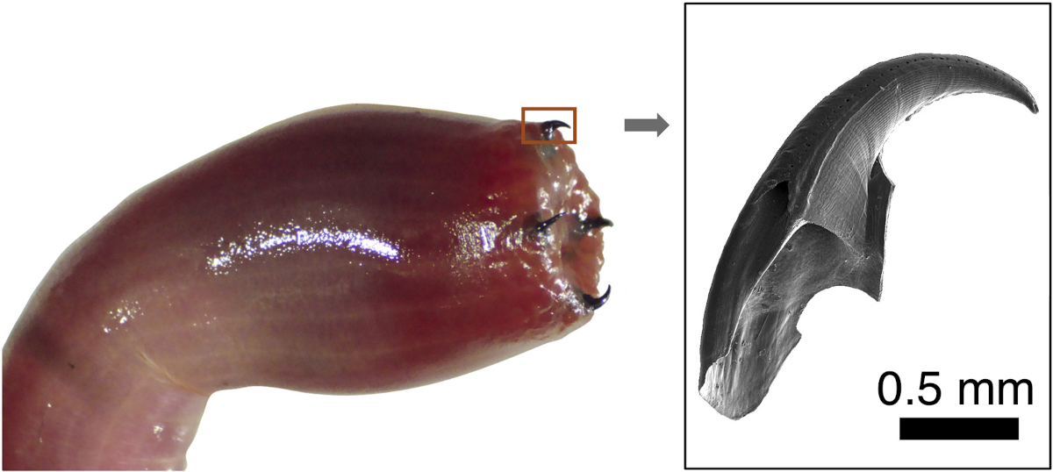
UC Santa Barbara MRSEC
DMR-1720256
A Multi-tasking Polypeptide from Bloodworm Jaws
Matthew Helgesen and J. Herbert Waite (IRG-3)
The key protein that helps bloodworms form copper-based mineral composites to make very strong jaws has been identified along with the several functions that it serves.
High-performance natural materials play a critical role in informing modern material design and development. For effective technological translation, research needs to scrutinize the mechanisms of each of these properties and how they relate to one another which is accomplished here. Copper binding underpins the formation of a dense protein liquid phase and enables melanin synthesis but later provides self-healing cohesive bridges between the proteins.
The results directly support the goals of IRG-3 as they develop an understanding of the processing pathways that nature uses to make useful materials.
The four exposed probosces that comprise the jaws of bloodworms. On the right is a scanning electron micrograph of a single jaw.
Notes:
What Has Been Achieved: Bloodworm jaws are composites of protein, melanin, and both mineral and ionic copper. To date, nanomechanical tests have correlated the ionic copper and melanin with hardness and wear resistance, but the function of protein is uncertain. In this work, a protein that carries out six distinct functions critical for jaw formation and performance, namely (1) recruiting copper ions, (2) mediating a liquid-liquid phase separation of the protein-copper complex, (3) catalyzing the oxidation of 3,4-dihydroxyphenylalanine (Dopa) to melanin, (4) templating the interfacial polymerization of melanin, (5) integrating melanin and itself into thin films and fibers, and (6) providing intermolecular cohesion through copper bridging. The protein achieves all these by assuming unprecedented roles as a building block, organizer, and fabricator — a processing feat of considerable relevance to the autonomous production of other polymer composites, blends, and/or networks.
Importance of the Achievement: High-performance natural materials play a critical role in informing modern material design and development. Bloodworm jaws, used for hunting and defense, are lightweight but with impressive impact and wear properties. The jaw composition is exotic at ∼10% copper and a blend of equal parts of protein and melanin, a pigment rarely used in load-bearing functions. Much of jaw material production is dependent on the properties of the protein, which include binding copper, phase separation, catalyzing melanin formation, and assembling the protein-copper-melanin blend. For effective technological translation, research needs to scrutinize the mechanisms of each of these properties and how they relate to one another. Copper binding underpins the formation of a dense protein liquid phase and enables melanin synthesis but later provides self-healing cohesive bridges between the proteins. The research has the potential to change the way we design, make, use, and dispose of our materials.
How is the achievement related to the IRG, and how does it help it achieve its goals? IRG-3 is all learning the processes by which nature exquisitely controls the creation of materials from simple ingredients and under mild conditions. This work is central to addressing some of the questions originally posed by IRG-3.
Where the findings are published: W. R. Wonderly, T. T. D. Nguyen, K. G. Malollari, D. DeMartini, P. Delparastan, E. Valois, P. B. Messersmith, M. E. Helgeson, and J. H. Waite, A Multi-tasking Polypeptide from Bloodworm Jaws: Catalyst, Template, and Copolymer In Film Formation, Matter 5 (2022) 1890–1908. DOI: 10.1016/j.matt.2022.04.001
Also: These Bloodworms Grow Copper Fangs and Have Bad Attitudes [NY Times article by By Veronique Greenwood April 30, 2022]

