Slide 1
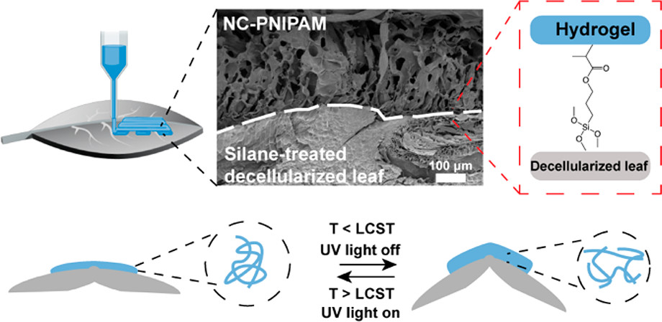
UC San Diego MRSEC
DMR-2011921
Plant Leaf ELMs Undergo Shape Shifting Driven by External Stimuli
Jiayu Zhao, Yvonne Ma, Nicole Steinmetz, Jinhye Bae, UC San Diego
Plant/polymer composite materials have been fabricated
These composite materials are stimuli responsive and can undergo shape-shifting behavior in response to temperature or light
Agriculture is essential to life, yet very few examples of ELMs involving plants have been achieved
This example supports one thrust of IRG 2: Shape shifting Engineered Living Materials
ACS Macro Lett. 2022, 11, 8, 961–966.
Notes:
What Has Been Achieved: Plant leaves have been patterned using direct ink write 3D printing to covalently append a LCST polymer and appropriate fillers. When the polymer undergoes the LCST transition, in response to temperature, the leaves can change shape based on the pattern that is printed on the leaves. The shape changing effect can be achieved through a change in temperature or irradiation, if a photo-responsive filler is included in the gel component.
Importance of the Achievement: Plants are essential for a wide variety of technology that supports human life (e.g. agriculture, building materials, O2 production, etc), however, little effort is given to using materials science and engineering tools to improve plant quality. The results of the work presented offer the potential for use in water retention, fire retardancy, biosensing, amongst many others.
How is the achievement related to the IRG, and how does it help it achieve its goals? Main thrust of IRG2 is shape-shifting materials that mimic actuation in living systems. This clearly falls in this realm and is the first example of what is known of that utilizes materials science to modulate leaf morphology.
Where the findings are published: ACS Macro Lett. 2022, 11, 8, 961–966: https://doi.org/10.1021/acsmacrolett.2c00282.

