Slide 1
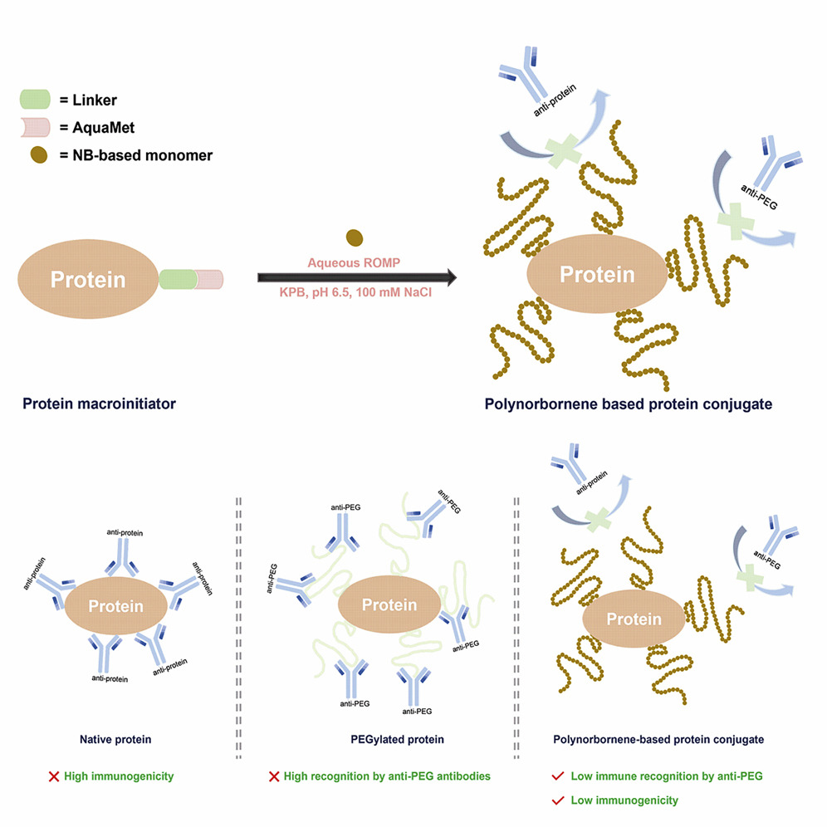

UC San Diego MRSEC
DMR-2011921
First Demonstration of Controlled Grafting-from ROMP Bioconjugates
Derek Church, Elizabathe Davis, Adam Caparco, Nicole Steinmetz,
Jon Pokorski, UC San Diego
This is the first demonstration of living ring opening metathesis polymerization (ROMP) from a biological substrate
Molecular weight control and complex monomer composition could be achieved
Adding new and complex polymers greatly advances the field of ELMs, especially because the polymerization is completed rapidly
The ability to easily incorporate and control complex polymer hybrids is at the core of IRG2 and is now being implemented for cell and plant- based ELMs
Cell Reports Physical Science, 2022, 3, 101067.
Notes:
What Has Been Achieved: This is the first example of controlled ROMP polymerization from a biological substrate. The polymerization proceeds rapidly (~10 minutes) which is critical for biological stability. The types of polymers that can be incorporated are vast and we have demonstrated biological activity of the polymers.
Importance of the Achievement: There is a desperate need for alternatives to polyethylene glycol in the bioconjugate world. This technique gives a bevy of options because it is living and functional group tolerant, meaning that the polymer length can be controlled, and complex monomers can be introduced to augment function.
How is the achievement related to the IRG, and how does it help it achieve its goals? A core tenet to IRG 2 is incorporating polymers with living matter. This technology is a simple and expeditious way to do so. It is now being applied to leaf-based systems in conjunction with highlight #1.
Where the findings are published: Cell Reports Physical Science, 2022, 3, 10, 101067.
https://doi.org/10.1016/j.xcrp.2022.101067.

