Slide 1
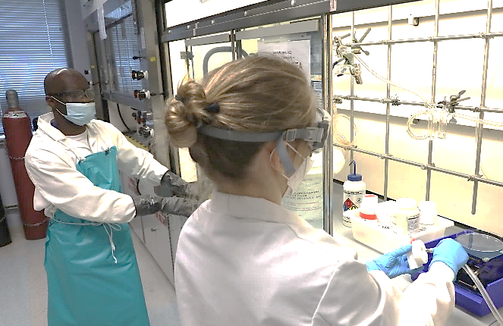
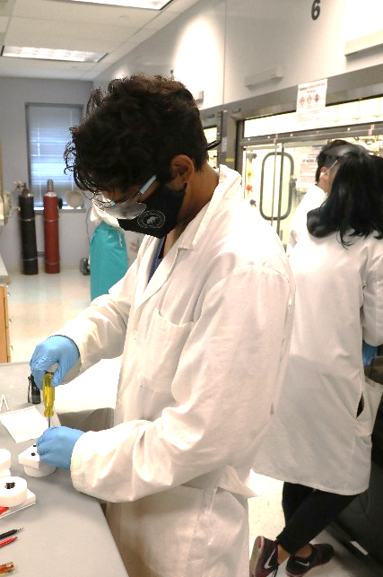
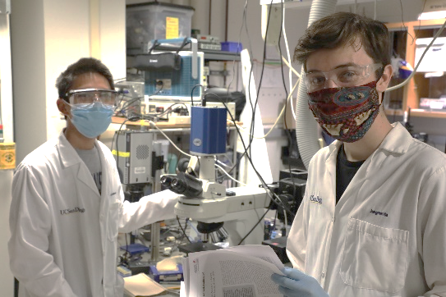
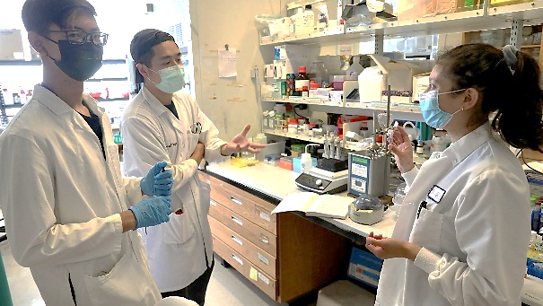
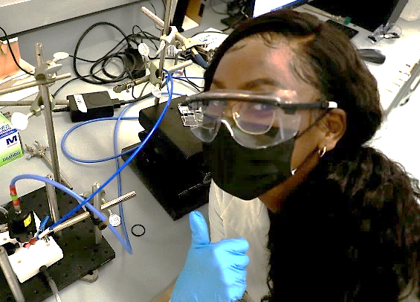
EHRD: Research Immersion in Materials Science & Engineering (RIMSE) Summer Schools
UC San Diego MRSEC
DMR- 2011921
2022
Michael Sailor, Tod Pascal, Andra Tao, Jonathan Pokorski, Stacey Brydges
University of California San Diego
Prepare trainees to engage in research, in MRSEC labs and within UCSD at large
Streamline high school students, undergraduate students (with a particular focus on transfer students), REU students, and incoming graduate students into research programs in the domains covered by the two IRGs.
Benefit incoming graduate students by enabling them to begin their research projects and position themselves on campus ahead of the Fall academic term
e)
Notes:
The UCSD MRSEC RIMSE Summer Schools prepare trainees to engage in research, in MRSEC labs and within UCSD at large. The program streamlines high school students, undergraduate students (with a particular focus on transfer students), REU students, and incoming graduate students into research programs in the domains covered by the two IRGs. The 2022 RIMSE Summer Schools portfolio includes: 1) Summer School on Silicon Nanotechnology; 2) Summer School on Predictive Assembly; 3) Summer School on Engineering Living Materials; and 4), Summer School on Battery Research

