Slide 1
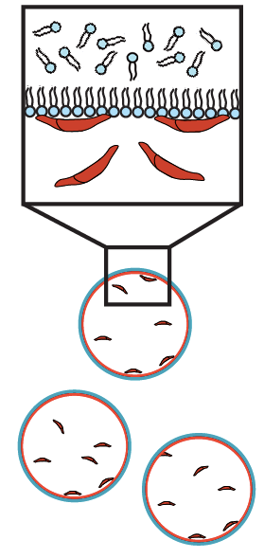
Directing actin polymerization to membranes
MRSEC 1420382
2017
C.F. Kelley, A.A. Rodal, Brandeis University
Biological membranes are deformed and shaped by proteins that assemble into higher-order scaffolds. These scaffolds target the force-generating polymerization of actin filaments to deform and shape the membrane.
MRSEC experiments show that membrane-remodeling proteins can be maintained in an autoinhibited state, preventing spurious actin polymerization in solution. Release from autoinhibition by multiple coincident inputs ensures that force is generated only at the membrane.
These principles can be applied to nanoparticles and engineered proteins to shape membranes in a temporally and spatially controlled fashion.
Cell-sized
water droplets
emulsified in
decane/lipid
Activated
F-BAR (SNAP549)
Actin polymerization
at membranes
Deregulated
F-BAR (SNAP549)
Actin polymerization
In solution
Notes:
[Nwk-SNAP549]=500nM, [Dap160SH3CD]=2uM [WASp]=50nM [Arp2/3]=50nM
[Actin] = 2uM (10% Oregon Green)

