Slide 1
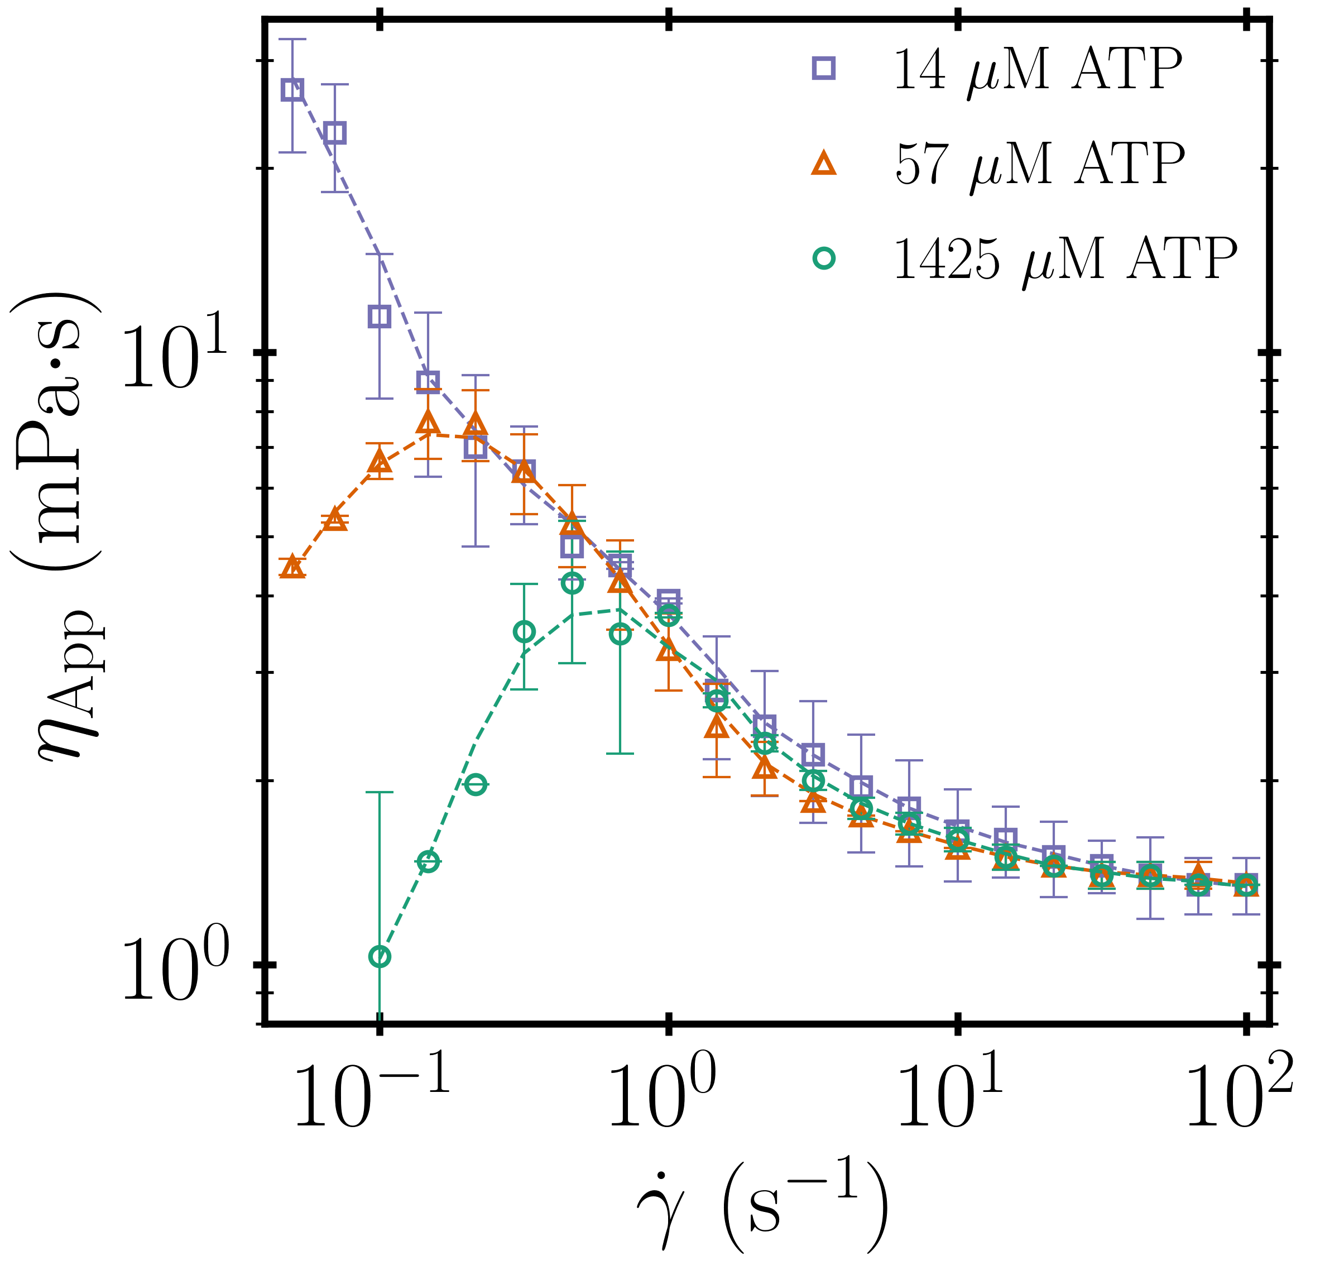
Rheology of active isotropic gels
DMR MRSEC 1420382
¹D. Gagnon, ¹C. Dessii, ²J. Berezney, ³R. Boros, ^{2,3}Z. Dogic, ¹D. Blair
¹Georgetown University, ²Brandeis University , ³UCSB,
Cytoplasmic flows, bacterial colonies, and algal blooms are ubiquitous examples of active
suspensions assembled from self-propelled particles, which internally inject energy into their suspending medium and, at sufficient concentrations, can produce large-scale flows. Linking macroscale material properties of active suspension to their underlying microscopic dynamics is a key challenge to describing these materials. Relying on the unique properties of microtubule based active matter and state of the art rheological techniques we measured the shear-rate-dependent viscosity, yield stress, and local dynamics of a model active suspension, while simultaneously quantifying their microscopy dynamics and autonomous flows. Our microtubule suspensions form a transient network with long-range mechanical contacts mediated by motor proteins and are best described as active gels. We find that activity coupled with external shear dramatically alters their apparent viscosity. We develop a simple model to explain the fundamental connection between an external deformation and microscopic dynamics that produce an anomalous mechanical response in active gels.
Structure and rheology of active gels: (left) A confocal reconstruction of an active gels composed of continuously rearranging extensile microtubule bundles that is driven by continuous input of energy through the motion of molecular motors. (right) Effective viscosity of a microtubule based active gels for three different ATP concentrations which controls the speed at which kinesin motors slide microtubules apart. The dashed lines represent a molecular model that explains the peak in the sample viscosity without any adjustable parameters.

