Slide 1
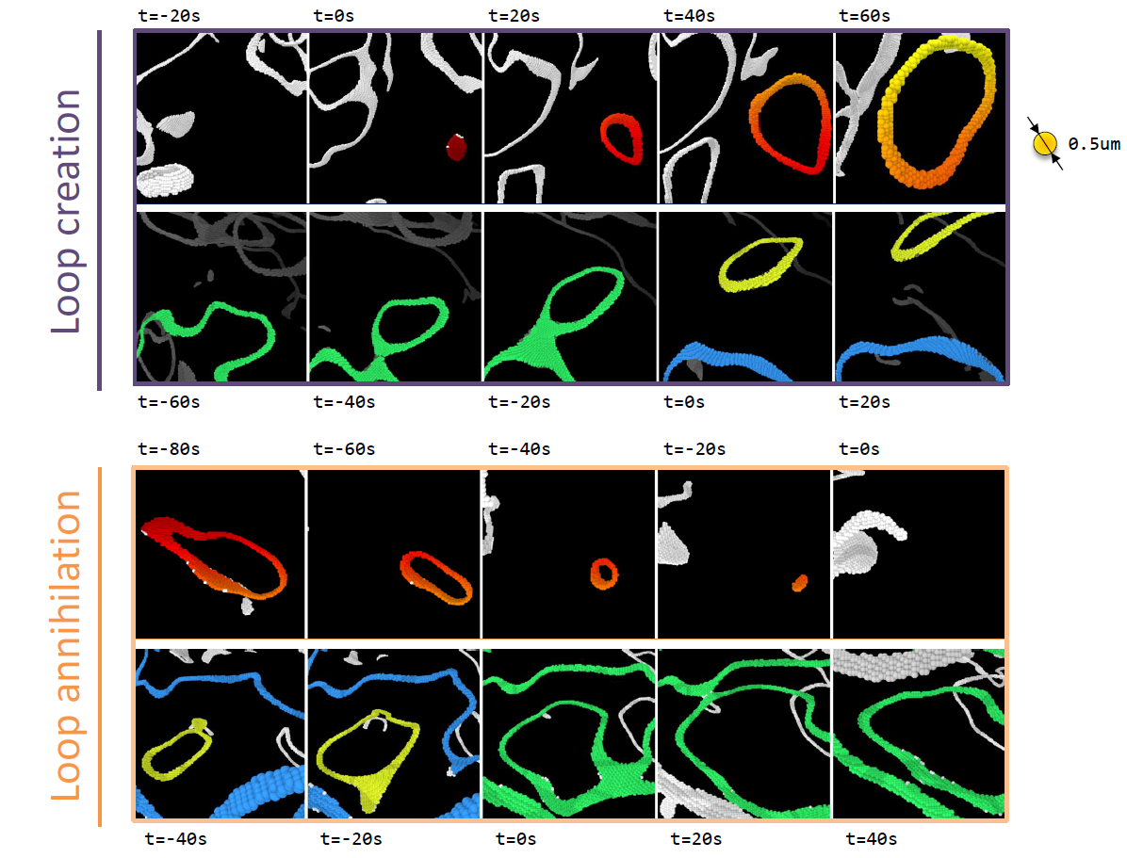
Disclination loops in 3D Active Nematics
DMR MRSEC 1420382
2019
G. Duclos⁴, D. Beller², R. Adkins¹, M. Varghese⁴ , M. Peterson^{4,} Arv. Baskaran⁴, R. Pelcovitz³, T. Powers³, S. Streichan¹, Ap. Baskaran⁴, M.F. Hagan⁴, Z. Dogic¹
¹UCSB, ²UC Merced, ³Brown University, ⁴Brandeis University
Current active matter systems, such as self propelled colloids or migrating cells, are inherently 2D, which limits the potential engineering applications. Brandeis developed the first 3D active nematic material by mixing an isotropic active fluid (Microtubules + kinesin motors) with a passive nematic colloidal liquid crystal (fd viruses). Using multiview light sheet microscopy, they explored the structure and the dynamics of topological defects in a 3D active nematic.
Both experiments and 3D hydrodynamic simulations suggest that topological defects in the turbulent regime are curvilinear. The defects form a complex network of lines and closed loops where neutral disclination loops are the generic excitations of 3D active nematics. The neutral loops can spontaneously nucleate from a uniform background through the bend instability, or split from the pre-existing network. The loops can also self-annihilate by closing on themselves or merge with the rest of the network. These events have also been indentified in 3D hydrodynamic simulations.
Dynamics of disclination loops in 3D active nematic. Topological loops can nucleate spontaneously from a uniformly aligned nematic through the bend instability. Loops can split from the existing percolating network. Equivalently, topological loops can also self-annihilate and merge with other existing loops. Colors highlight the loops of interest
Notes:
Include a technical description of the work here in the Notes section.

