Slide 1
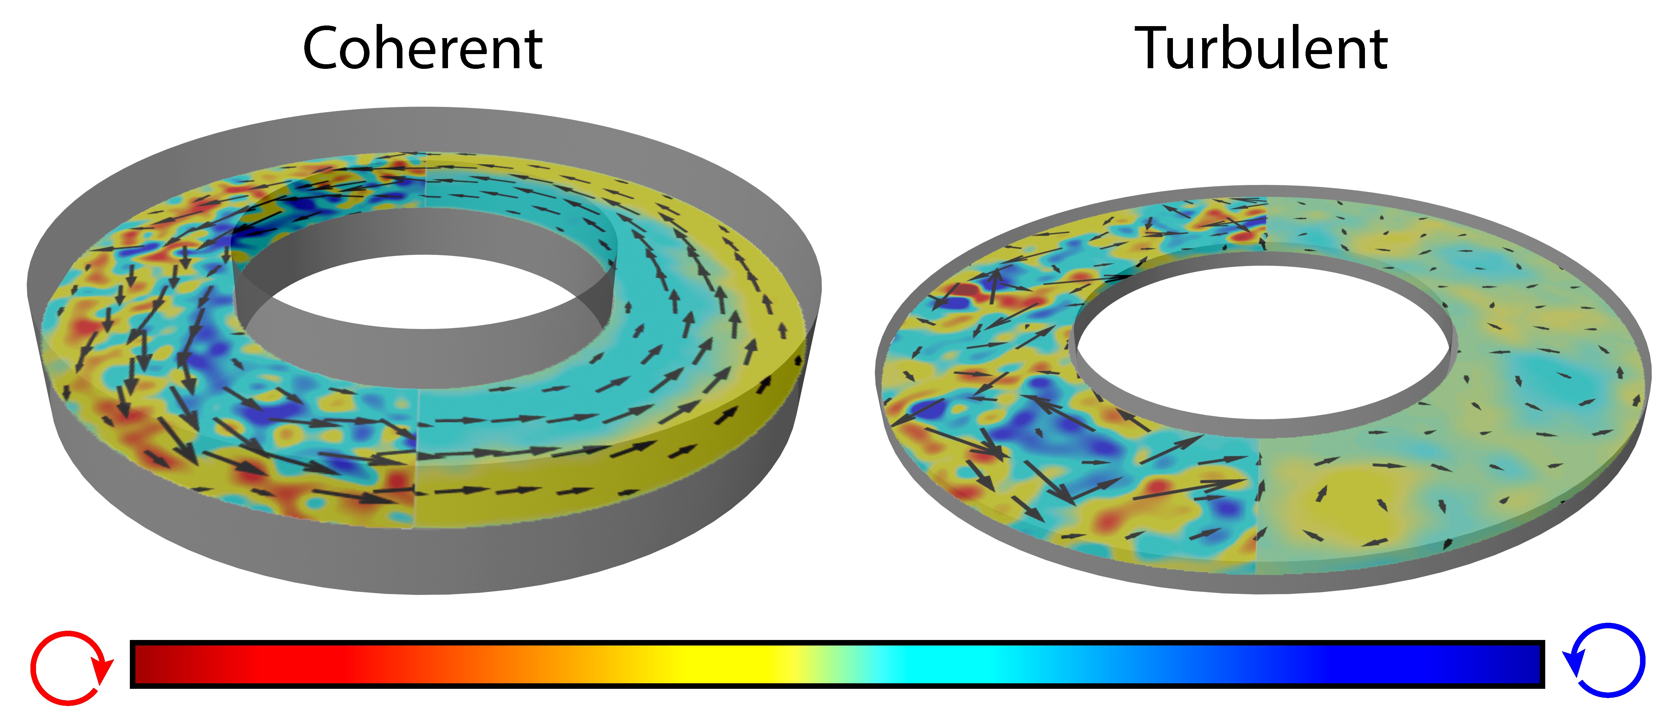
Coherent flows in confined 3D active isotropic fluids
DMR MRSEC 1420382
2017
Navier-Stokes equations dictate that the conventional fluid flows only in response to an externally imposed gradient in stress or a body force. We developed a novel active fluid that is comprised of microtubules and energy consuming molecular motors kinesin. We demonstrate that upon confinement, such active fluids undergo an inherently non-equilibrium transition from local chaotic flows to globally coherent flows that have long range order and are capable of transporting matter on macroscopic (meter) lengthscales. Our work uncovers a simple scale invariant criterion that predicts the location of the transition to coherent flows, and demonstrates that the formation of coherent flow is accompanied by the formation of a nematic layer that wets the confining boundaries at a specific oblique angle.
Seth Fraden and Zvonimir Dogic, Brandeis University
Increasing the height of the annulus induces a transition from locally-turbulent to globally-coherent flows of a confined active isotropic fluid. The left and right half-plane of each annulus illustrate the instantaneous and time-averaged flow and vorticity map of the self-organized flows. The transition to coherent flows is an intrinsically 3D phenomenon that is controlled by the aspect ratio of the channel cross-section, and vanishes for channels that are either too shallow or too thin.
Wu et. al, Science, 355, eaal1979 (2017)
Notes:
Until now the vast majority of active matter studies have been limited to 2D systems. We study more challenging 3D active isotropic fluids, finding that system dimensionality plays a fundamental and unexpected role. In particular, previous studies have demonstrated that coherent motion in active matter is only possible for confinements smaller than the inherent system lengthscale, such as the vortex diameter. We demonstrate that this is not the case for 3D systems. Previously we studied microtubule based active isotropic fluids in unconfined geometries and observed turbulent flows comprised of localized vortices. We identify a class of geometrical confinements that robustly transform such turbulent dynamics into long-ranged coherent flows. Surprisingly, our method work across multiple lengthscales, even for geometries that are orders of magnitude larger than the average vortex size. Somehow the boundaries determine the dynamical state of the system irrespective of its size. Extensive experiments reveal that the transition to coherent flows is controlled by the dimensionless aspect ratio of the channel profile, rather than dimensionful channel size. Our experiments further demonstrate that the transition between turbulent and coherent active flows is an intrinsically 3D effect that is impossible in previously studied systems with reduced dimensionality.

