Slide 1
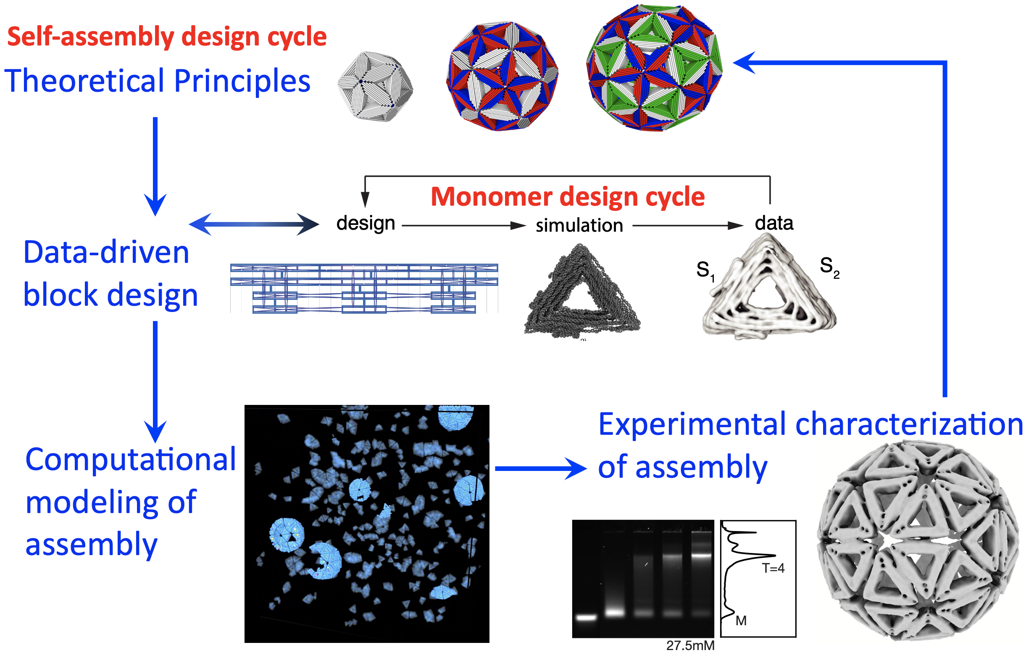
Self-assembling DNA Origami Shells
DMR MRSEC 2011846
2022
S. Fraden¹, M. Hagan¹, W. Rogers¹, G. Grason², H. Dietz³ ¹Brandeis University, ²U. Mass. Amherst, ³Tech. Universität München
The self-assembly of biological molecules into large, but finite-size, superstructures is fundamental to life. A grand challenge for colloidal self-assembly is to produce colloidal monomers with valence-limited interactions, that have arbitrary angles and strengths, to produce structures with the precision, complexity and functionality of biological assemblies. The Brandeis MRSEC solved this challenge in 2021. The process they developed is general and uniquely adaptable to a wide range of problems in colloidal self-assembly.
The design process consists of two nested loops of data-driven design cycles. In the monomer design cycle, colloidal monomers are built from DNA origami with sub-nm precision. In the self-assembly design cycle, the monomers join into a hierarchy of shapes.
Sigl, Fraden, Hagan, Dietz. Nat. Mater. 2021

