Slide 1
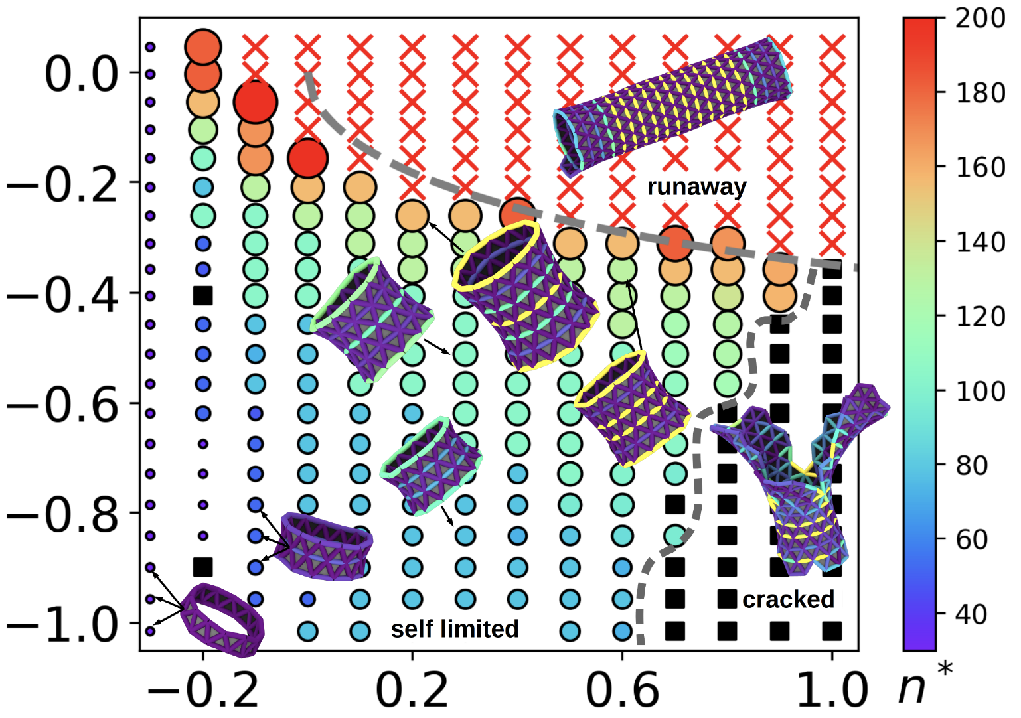
Frustrated self-limiting assembly of trumpets
DMR MRSEC 2011846
2023
Tyukodi, B.¹, Mohajerani, F.¹, Hall, D. M.², Grason, G. M.², and Hagan, M. F.¹
¹Brandeis University, ²U. Mass. Amherst
Triangular monomers with positive curvature in one direction and negative curvature in another assemble into trumpet shaped objects predicted to have precise self-limited lengths due to frustration-induced stress. However, the continuum theory does not account for potential mechanisms by which the system could “escape” frustration. Computer simulations revealed two escape routes; runaway, in which trumpets flatten and cracked, in which trumpets escape frustration by forming defects that locally release elastic strain.
Curvature
Binding strength
Phase diagram of trumpets. Symbols indicate phases: self-limited (circle), cracked (square), and runaway (red ‘x’). For the self-limited phase, symbols are colored and sized according to the optimal size n*. The gray dashed line is the result of a scaling argument.

