Slide 1
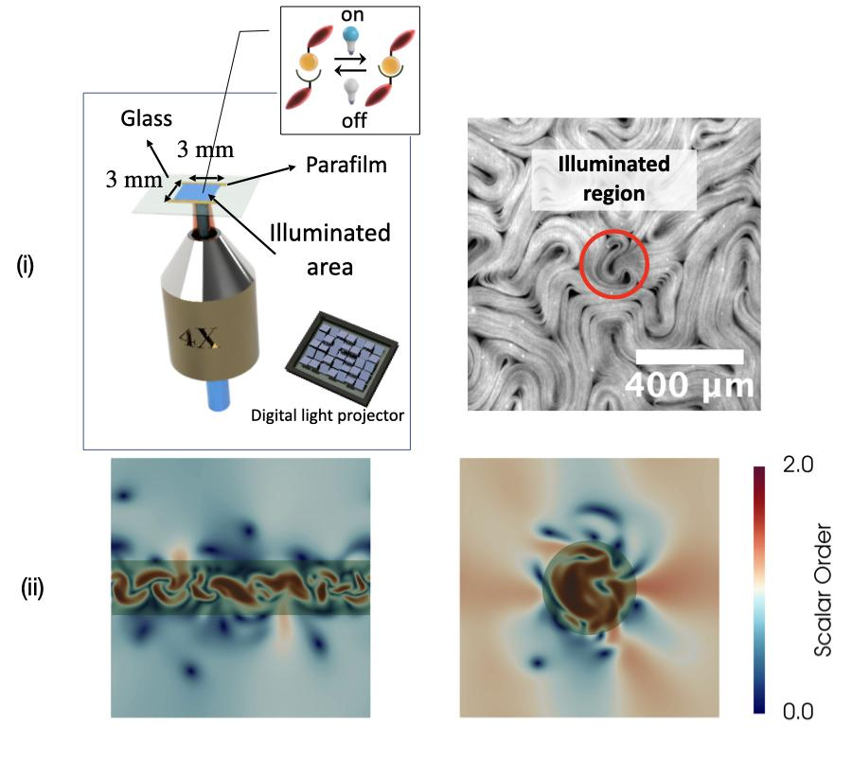
Spatiotemporal control of active materials
DMR MRSEC 2011846
2022
¹Duclos, ¹Fraden, ^{1,2}Dogic , ¹Baskaran, ¹Hagan, ¹Hong ¹Brandeis University, ²UCSB
Biological cells control spatial and temporal generation of active stresses to achieve diverse sought-after functionalities ranging from motility to cell division. Motivated by these observations IRG2 goal is to control of spatiotemporal patterns of active stresses and to endow soft materials with lifelike functionalities. Achieving these goals requires development of new elements of active stress that are under external control as well as developing theoretical models that can predict how these stresses are controlled in space and time to generate targeted dynamics.
Optical control of 2D active nematics – (i) (Left) Schematic of experimental set up. (Right) Snapshot of Local light activation bench mark experiment. (ii) Numerical solution of hydrodynamics with local activation in the form of a stripe (left) and a circle (right).
Notes:
Dogic developed light-activable molecular motors that show high contrast in activity between on and off states and has demonstrated consistency and repeatability in experimental outcomes. Fraden developed an optical microscopy module that generates predetermined spatiotemporal patterns of light to be projected on the sample plane. Duclos projected light on small regions of the light activable materials to generate activity in confined regions. Baskaran and Hagan are building a model predictive optimal control framework that identifies spatial patterns of light needed to drive systems into predetermined dynamical states. Ongoing experiments are benchmarking activity for given light intensities and the simulations are relating benchmarks for time scales and length scales necessary for robust control of dynamics (Figure). Once completed, the IRG will build on these foundational works to drive light controlled 2D active nematics into targeted dynamical states including a shear banded flow state, vortex arrays and dancing defect configurations.

