Slide 1
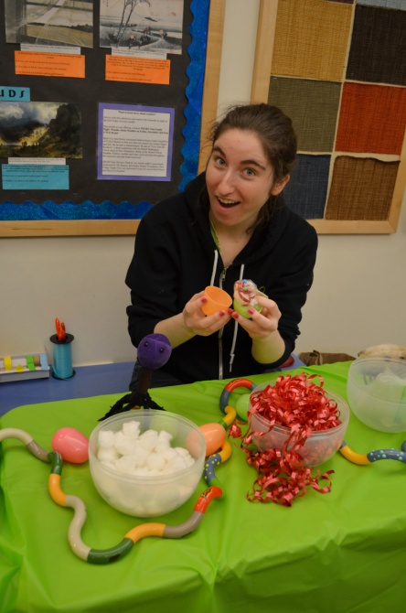
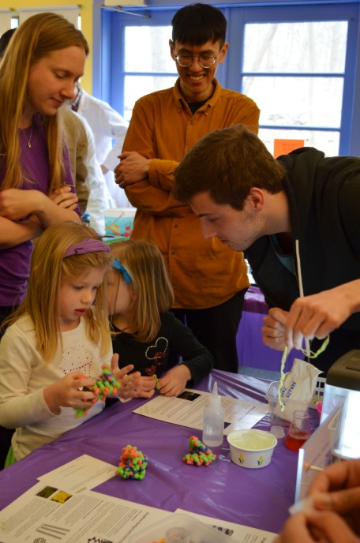
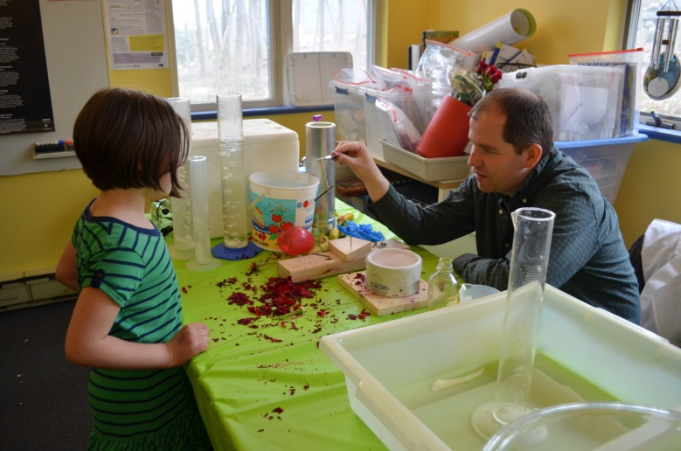
Brandeis MRSEC DMR-0820492 Informal Science Education Outreach Program: Discovering Nanolife Partnership with the Discovery Museum
MRSEC scientists from Brandeis visited the Discovery Museum in Acton for a full day of Microscope-themed activities on March 30th. We led hands-on activities that allowed students to see and build their own mutant Drosophila, assemble their own polymer chain and explore freezing techniques like dry ice and liquid nitrogen. We had over 150 museum guests participate in our activities.

