Slide 1
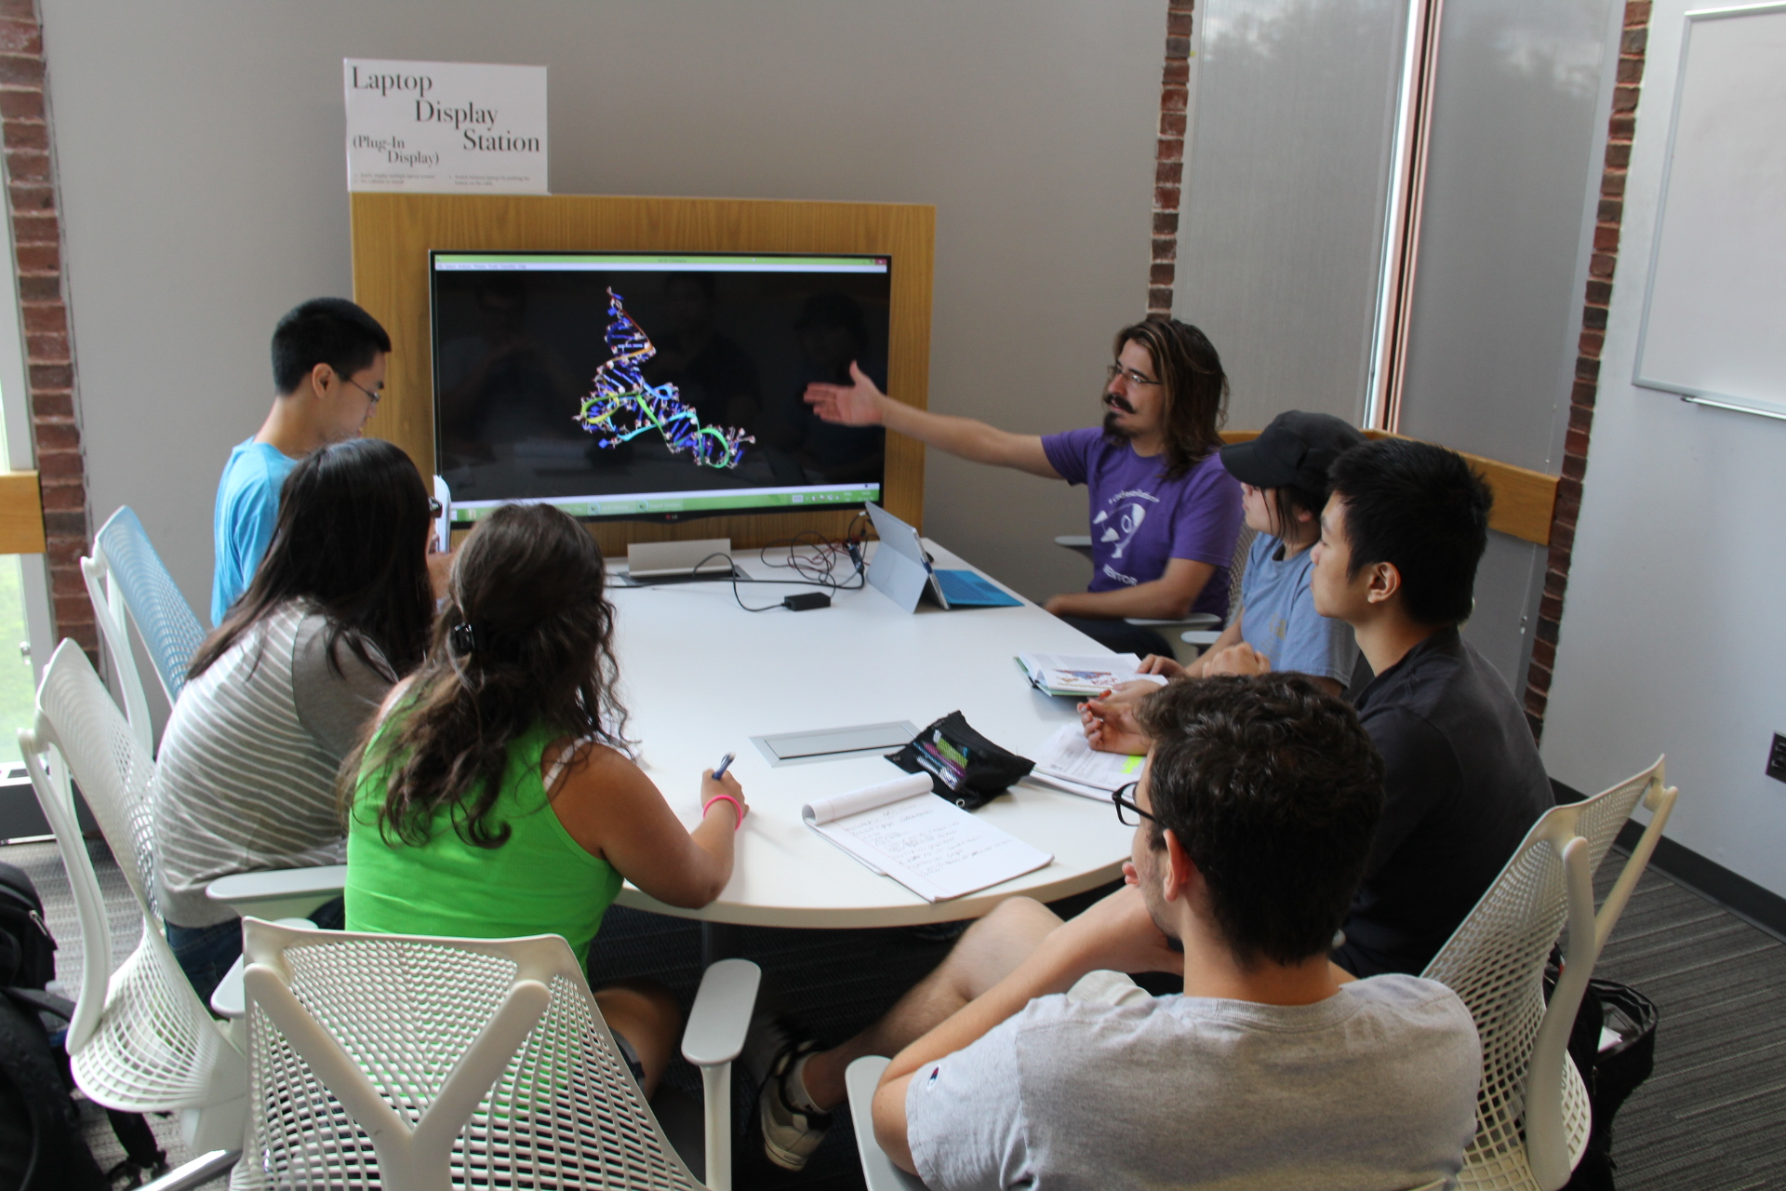
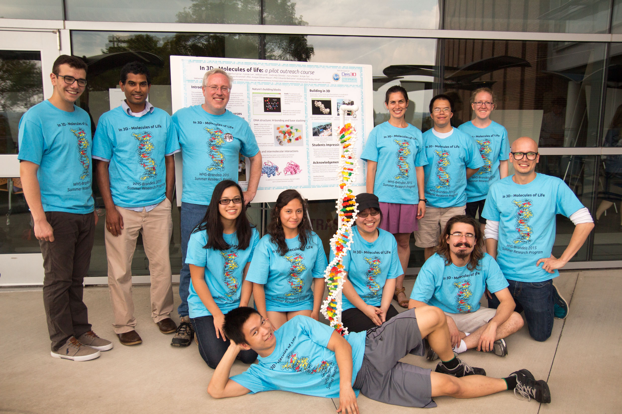
Brandeis MRSEC and Waltham High School
“In 3D – Molecules of Life” Course
Olivier-Mason, D. Pomeranz Krummel, I. Roy
Outreach: Brandeis MRSEC 1420382
Waltham High School students taking the course
The students and teaching team with the 3D printed DNA model
In 2015, the MRSEC led the development of an outreach course at Brandeis for Waltham High School students to strengthen our engagement with the WHS community. The course was structured to teach the students biochemistry using 3D molecular models, hands-on activities, CAD, and 3D printing. The class sessions were taught by graduate student and postdoc instructors who received extensive one-on-one curriculum-development mentoring by the Education Director and were encouraged to pursue a hands-on and participative class format.
Notes:
Two

