Slide 1
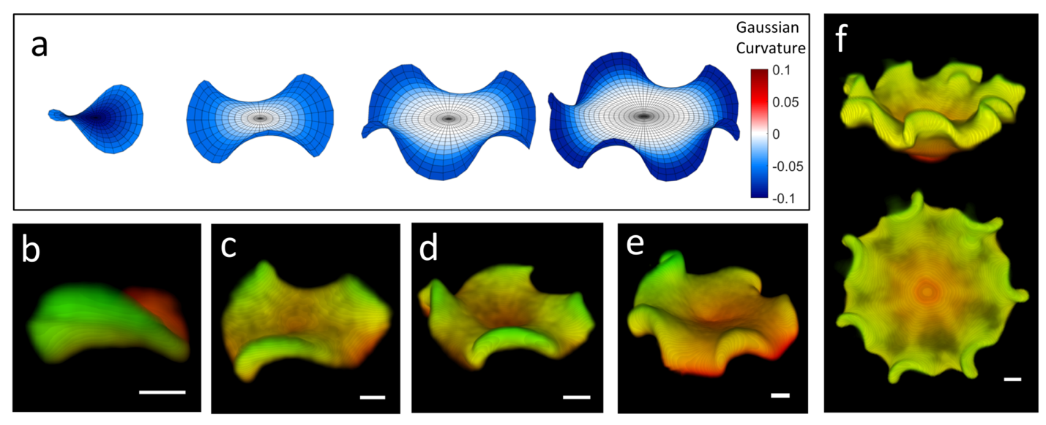
Deformation and orientational order of chiral membranes with free edges
DMR MRSEC 1420382
2020
L. Ding¹, R. A. Pelcovits¹ T. R. Powers¹ and ^{2,3}Z. Dogic.
²Brandeis University, ¹,Brown University, ³UCSB
Producing self-assembled structures of prescribed limited size and shape is a major challenge in nanoscience. A major achievement of the MRSEC was to elucidate a new chirality-based mechanism that leads to self-limiting assembly of colloidal rafts. A two-dimensional colloidal membrane with free edges and
composed of chiral rod-like viruses is an example where both chirality and membrane deformability are key components of the system. The interplay of chirality and deformability leads to the formation of beautiful three-dimensional Enneper structures driven by the negative Gaussian curvature of the membranes that arises because of the chirality of the molecules. Experiments on membranes formed from filamentous virus were combined with theory and computation in this study.
Theory and Experiment on self-limited sized membranes formed from rodlike chiral liquid crystalline molecules. (a) Theory: Enneper surfaces of m=1, 2, 3, and 4. (b—e) Experiment: Membranes formed from the filamentous virus fd. 3D false-colored confocal images of saddles with order m=1, 2, 3, and 4. (f) Experiment: 3D rendered images of an m=6 order saddle surface. All scale bars are 2 μm.

