Slide 1
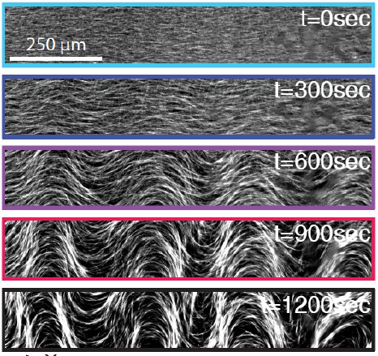
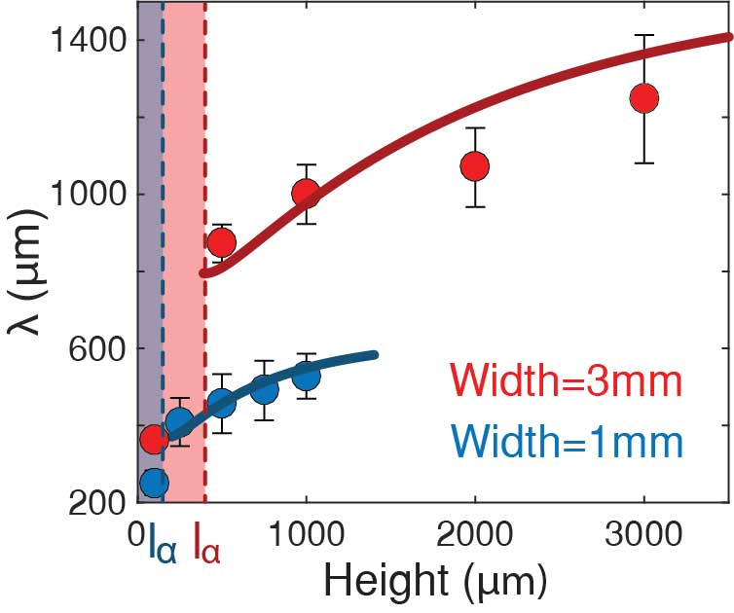
Confinement Controls the Bend Instability of Three-Dimensional Active Liquid Crystals
DMR MRSEC 1420382
2020
¹G. Duclos, ¹A. Baskaran, and ^{1,2}Z. Dogic. ¹Brandeis University, ²UCSB
Spontaneous growth of long-wavelength deformations is a defining feature of active fluids with orientational order. In particular, for unconfined extensile active nematics, minimal hydrodynamic models predict that the fastest-growing deformation has an infinite wavelength. Here [1], three IRG2 PP developed a combination of experiments with 3D active fluids confined in microfluidic channels and a minimal hydrodynamic model to show that size of the channel determines the emergent lengthscale of the growing deformations. These findings will advance our understanding of active nemato-hydrodynamics and the pathways to 3D active turbulence at low Reynolds number.
[1] Chandrakar, Varghese, Baskaran, Dogic, and Duclos, Phys. Rev. Lett. 125, 257801
Bend-twist instability in confined 3D active nematics.
Chandrakar et al. studied the impact of confinement on the instability of a 3D active liquid crystal composed of microtubule bundles and kinesin molecular motors. Combing experiments with fluorescent microscopy and linear stability analysis of an hydrodynamic model, they showed that bend and twist deformations are coupled leading to an in plane instability whose wavelength depends on the out-of-plane confinement.

