Slide 1
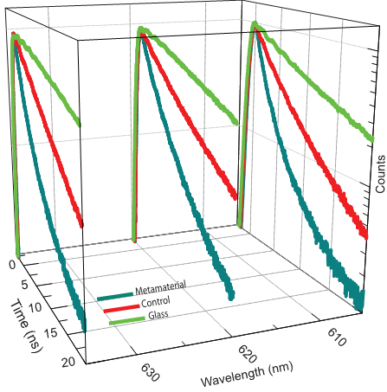
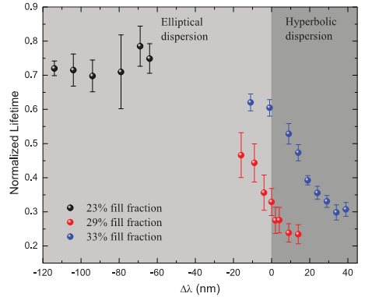
Optical Topological Transition in Metamaterials
Harish Krishnamoorthy,¹ Zubin Jacob,²Evgenii Narimanov, ³ Ilona Kretzschmar,⁴ and Vinod Menon^{1,*}
¹Queens College and Graduate Center of CUNY, ² University of Alberta, ³Purdue University, ⁴ City College of CUNY
vmenon@qc.cuny.edu
(Left) Broadband control of spontaneous emission using anisotropic metamaterials. (Right) Modification in spontaneous emission lifetime observed when the system undergoes the OTT
Manipulating the topology of iso-frequency surface provides a new approach for control of light-matter interaction. This is demonstrated using anisotropic metamaterials consisting of metal-dielectric layers.
Science 336, 205 (2012)
Optical topological transition (OTT): The optical iso-frequency curve changes from a closed surface such as an ellipsoid to an open hyperboloid (top). This transition is associated with a dramatic increase in the light intensity inside the metamaterial (bottom)
Sponsored by NSF-MRSEC
through contract DMR-1120923
Notes:
Control of spontaneous emission from colloidal CdSe quantum dots placed in the vicinity of the anisotropic metamaterial undergoing OTT is demonstrated via steady state and time resolved PL measurements.

