Slide 1
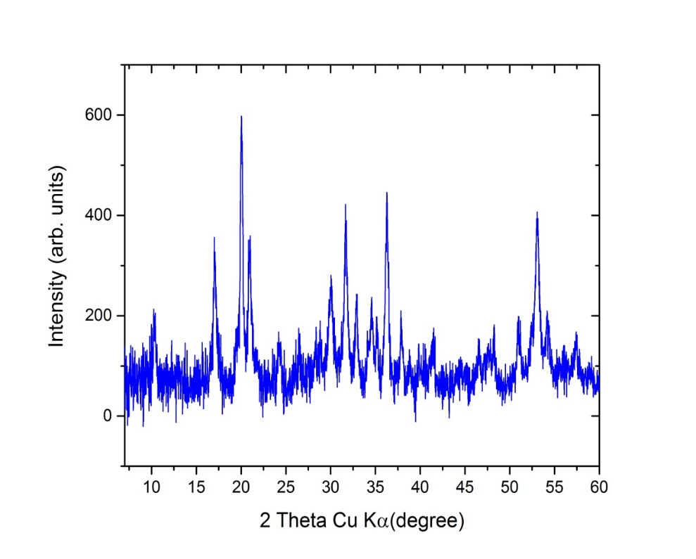
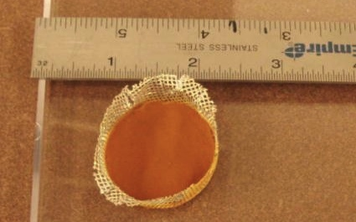
Synthesis of Si Clathrate using Si nanoparticles Lakshmi Krishna, Carolyn Koh, Reuben Collins, Craig Taylor Renewable Energy REMRSEC, NSF DMR-0820518
We have demonstrated that using silicon nanoparticles as a starting point significantly improves the kinetics of silicon clathrate formation. Removal of sodium from the final clathrate phase is also accelerated with the nanoparticle precursor. This becomes an attractive route to large scale synthesis of a novel allotrope of silicon.
Na₁Si₁₃₆
x<1 as synthesized
*Type I
*
Dilute Ar:SiH₄
(Si Qdots)
RF
Nozzle Size
(0.1-0.9 mm)
Notes:
Inorganic type II clathrates are low density, semiconducting allotropes of group IV elements with the potential for optoelectronic applications. Si clathrate is routinely synthesized by passing from diamond silicon to sodium filled silicon clathrate using a sodium silicide intermediate. Here we synthesize NaSi by using Si nanoparticles and reacting it with NaH. We find that the NaSi quickly converts to clathrate upon heating and the Na removal process is much faster in this synthesis when compared to the clathrate synthesis using bulk Si as Si source.
Si nanoparticles are grown by using a RF plasma synthesis. We are able to tune the particles sizes between 4 nm to 10 nm.

