Slide 1
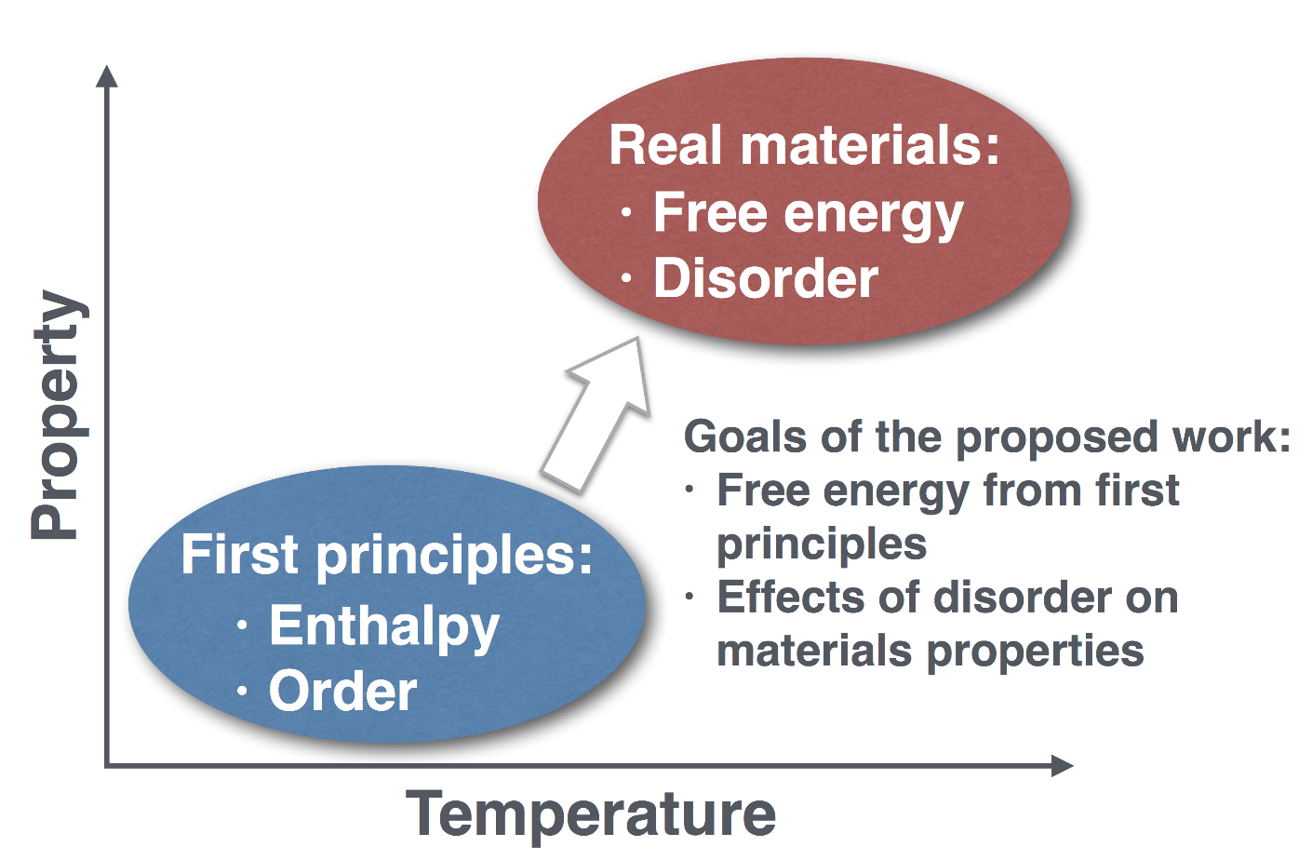
The Materials Genome Gets Hot!
V. Stevanovic, R. O’Hayre, A. Zakutayev
REMRSEC, NSF DMR-0820518
The goal of this seed project is to bring first-principles theory closer to experimental reality by accounting for the finite temperature effects that are essential for describing the behavior of “real-world” materials at their typical operating conditions.
Our initial studies focus on materials for solar thermochemical water splitting and materials for high-T fuel cells. Predicting high-T behavior is crucial to both areas.
Level of Sophistication
Notes:
This project aims to incorporate finite temperature effects into modern materials by design through tight integration of high-throughput computation with high-throughput materials synthesis/characterization. Our vision is to bring first-principles theory closer to the experimental reality by accounting for the finite temperature effects that are essential for describing the behavior of “real-world” materials at their typical operating and/or growth conditions. Our initial seed effort combines theory and experiment to explore the compositional space and associated finite temperature phenomena in the recently discovered triple conducting oxide Ba(Co,Fe)(Zr,Y)O_{3-δ} (BCFZY). This material system allows simultaneous conduction of electron holes, protons, and oxygen ions at high temperatures (300-700 ºC), thereby enabling world record-breaking protonic ceramic fuel cell performance¹. The material is also of great interest for oxygen permeation membranes and electrochemical sensor applications. Nevertheless, little is known about BCZFY, and its rich compositional landscape is essentially unexplored. As this material system combines compositional complexity with a richness of finite temperature phenomena including both atomic and spin disorder it provides an ideal case-study for “heating up” the materials genome.
¹ C. Duan, J. Tong, M. Shang, S. Nikodemski, M. Sanders, S. Ricote, A. Almansoori, and R. O’Hayre, Science, 349, 1321 (2015).

