Slide 1
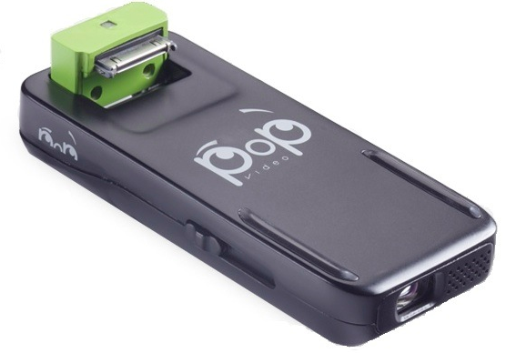
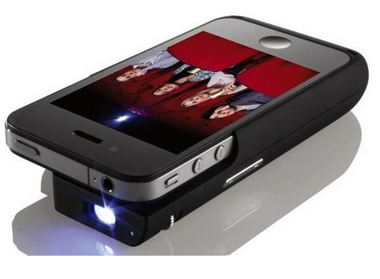
Ferroelectric Liquid Crystal-Based Pico-Projectors
Center researchers are collaborating with spin-off Displaytech (now part of Micron Technologies) to develop ferroelectric liquid crystal (FLC) materials for application in picoprojectors. The high-quality time sequential color and high brightness enabled by FLC switching speed, and high fill factor and ultra-small pixels achievable with FLCs makes FLC-on-silicon the choice display technology for picoprojectors. FLC-based pico-projection continues to advance with the $99 POPVIDEO iphone projector shown in the image, recently introduced by Micron/Displaytech.

