Slide 1
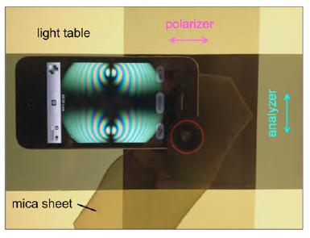
•Fisheye Lens Conoscopy with the iPhone
LCMRC researchers, motivated by a request from one of the Center's spin-off companies, have developed fisheye lens conoscopy, one of the most significant developments in the characterization of the birefringence of materials in the last 150 years, Its implementation with the iPhone camera makes optical monitoring of polymer and liquid crystal films in application and production particularly inexpensive and uniquely powerful.

