Slide 1
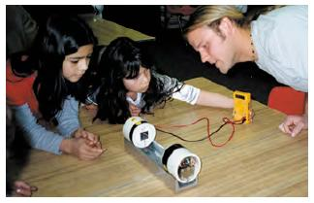
•Materials Science from CU
MSFCU has been extraordinarily successful in reaching Colorado K-12 students with physical sciences presentations tuned for the Colorado curriculum. To date nearly 2000 classes have served over 78,000 Colorado K-12 students. These presentations provide an excellent way for Center faculty, graduate, and undergraduate students to share their knowledge and enthusiasm about science with the community. This collaboration allows the effective communication of exciting research and informs the public about the common applications of chemistry, physics and engineering, in the context of a highly regarded and well established science education program.

