Slide 1
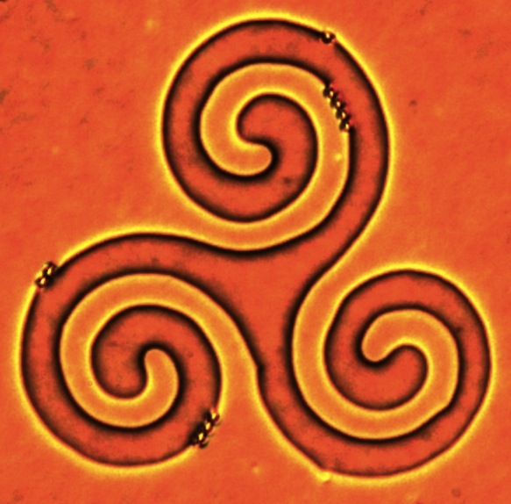
Moving and Rotating Particles with Low Light Levels
LCMRC researchers have developed a method for manipulating particles by light without touching them by using liquid crystals as a light-controlled host fluid. The LC host reduces the illumination required by factors up to 10,000X relative to direct manipulation with optical tweezers, to the extent that lasers are no longer needed for many applications. LCMRC designed and synthesized photosensitive azobenzene monolayers control the LC orientation, which in turn moves the particles. The image illustrates that dynamic complex patterns can be generated, making optical manipulation suitable for a number of applications and development of new types of photoresponsive composite materials.

