Slide 1
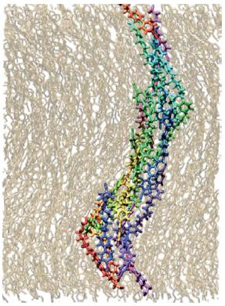
•The Twist-Bend Nematic phase
LCMRC researchers have found an extraordinary nematic liquid
crystal phase, a new entry in the most widely studied and widely
applied class of liquid crystals. In the whole history of liquid
crystals only four distinct nematic ground states have been
found: the uniaxial, the biaxial, and, for chiral molecules, the
helical nematic and blue phases. The “twist-bend” phase
reported here is a fundamentally new type of nematic state
exhibiting the first layer-free liquid crystal ordering with
coherent structure on the nanoscale. Its spontaneously chiral
conical helix, appearing as broken symmetry since the bent
molecular dimers are achiral, exhibits the amazingly short pitch
of 8nm, making it the liquid crystal coherent ordering, illustrated
by the atomistic simulation in the figure, that is closest in scale to
the molecular size, in this case 3nm. This discovery, as a result,
promises a unique opportunity to advance liquid crystal science
at the interface of molecular design and soft matter physics.

