Slide 1
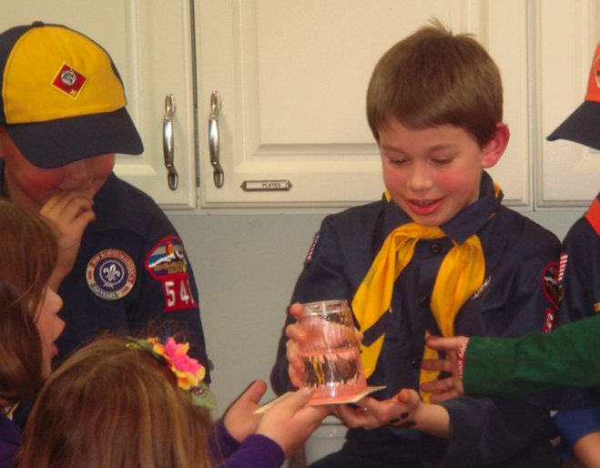
Tricks with Water
If you tell your mother that your science class today is called "tricks with water" then she might tell you to try not to get wet. But in this class, getting wet is half the fun, along with cast iron bombs that explode, paint cans that implode, lead that turns into gold, a cruise liner that floats in a cup of water, and water that boils when it gets cold. Its all part of a Materials Science from CU class that teaches the basics of phase change, bouyancy, pressure, and vacuum, one of many MSFCU classes presented to 3,800 K5-K9 students by LCMRC staff over the past year.

