Slide 1
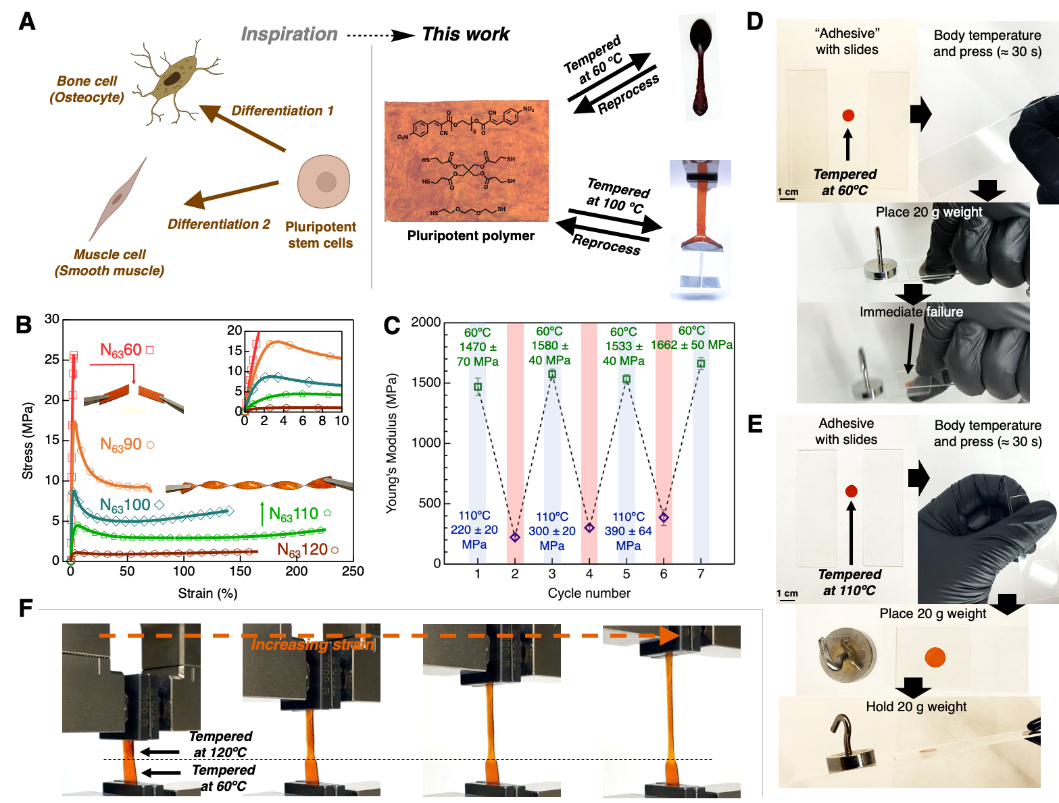
University of Chicago MRSEC
DMR-2011854
Accessing pluripotent materials through tempering of dynamic covalent polymer networks
Boynton, N. R., Dennis, J. M., Dolinski, N. D., Lindberg, C. A., Kotula, A.,
Grocke, G. L., Vivod, S. L., Lenhart, J. L., Patel, S. N.*, Rowan, S. J.*
Inspired by pluripotent stem cells, that can be differentiated into a range of cells, a synthetic, pluripotent plastic has been developed (Figure A). This material can be tempered (isothermal heating before rapidly quenching) at various temperatures to access a range of room temperature properties from hard and stiff to soft and extensible (Figure B). With this ability, the materials can be used, reused, and recycled (Figure C) to access a range of common, plastic properties. Through choice of the tempering temperature, it is possible to access stiff robust materials that can used to make utensils (i.e., spoon) or soft extensible shape memory materials that can actuate and lift weights (Figure A). In addition, the materials can be tempered to have a different function. For example, the material tempered at 60 °C is stiff and can be utilized as a spoon (Figure A) but it fails as an adhesive (Figure D). However, by tempering at 110 °C the material is now soft and extensible at room temperature and can be used as a pressure-sensitive adhesive (Figure E). We also show that these materials can be differentially (or spatially) tempered (akin to the process to make swords) to access single films that have regions that are soft/extensible and regions that are have stiff/high-strength properties (Figure F).
Science 2024, 383, 545-551. DOI: 10.1126/science.adi5009
Notes:
What Has Been Achieved: In this highlight, we report the development of a polymeric, pluripotent material that can be tempered (akin to the process in metallurgy) to access a wide range of room temperature mechanical properties, from stiff and high strength to soft and extensible, from a single feedstock. The feedstock was composed of a benzalcyanoacetate-based Michael acceptor, a tetrathiol crosslinker, and a dithiol chain extender to form dynamic thia-Michael networks.
Importance of the Achievement: In resource-scarce areas, materials must be used for a multiple purposes and having access to a single feedstock that can be tuned across a broad property scope could be advantageous for astronauts, soldiers, etc. From a sustainability perspective, current plastic recycling suffers from having a variety of polymer types in use that must be sorted before recycling due to immiscibility of the polymers that prevents further reprocessing. A single feedstock that can be used in range applications (that currently require different polymers) could be readily mixed and significantly reduce the burden of plastic recycling, while further limiting the amount of plastic that is discarded in landfills.
How is the achievement related to the IRG, and how does it help it achieve its goals? In these materials, tempering acts as the training mechanism to fix the material behavior for a desired time period, before it can be tempered again to access a completely different property scope. This is all done without the need for any sort of chemical modification.
Where the findings are published: Science 2024, 383, 545-551. DOI: 10.1126/science.adi5009
Affiliations: ¹Pritzker School of Molecular Engineering, University of Chicago, Chicago, IL, USA
²United States Army Research Laboratory, Aberdeen Proving Ground, MD, USA
³Materials Science and Engineering Division, NIST, Gaithersburg, MD, USA
⁴NASA Glenn Research Center, Cleveland, OH, USA
⁵Center for Molecular Engineering, Argonne National Laboratory, Lemont, IL, USA
⁶Department of Chemistry, The University of Chicago, Chicago, IL, USA

