Slide 1
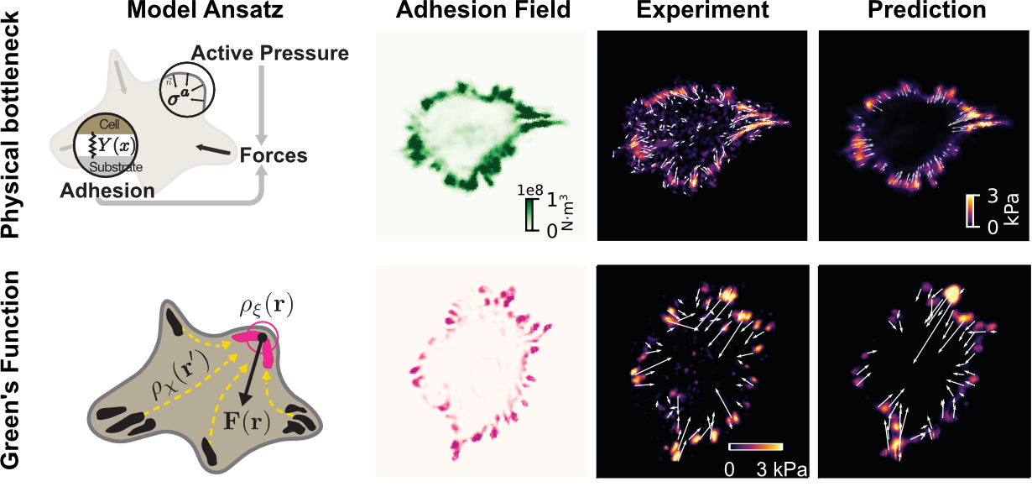

University of Chicago MRSEC
DMR-2011854
Machine learning interpretable models of biomaterials from chemistry
Vitelli and Gardel groups
Cellular form and function emerge from complex mechanochemical systems within the cytoplasm. However, no systematic strategy exists to infer large-scale material properties of a cell from its molecular components. To tackle this issue, Gardel and Vitelli developed new deep-learning methods to infer mathematical models for the mechanics of cells directly from measures of the cells’ chemical contents. Surprisingly, neural networks revealed that a single protein was enough to reconstruct the cellular force distribution. To use this insight to construct models which could yield insight into the cell’s mechanics, we combined neural networks with physics to machine-learn models which are interpretable by construction (see Figure).
This work demonstrates how machine learning can be used to infer how biological materials achieve targeted material properties from distributed enzymatic activity. Our application of these methods to living cells is a stringent test of the approach in a situation where we have very little a priori knowledge about the material, but the pipeline itself is generic.
M.S. Schmitt, J. Colen, …, M.L. Gardel, P.W. Oakes, V. Vitelli (2024) Machine learning interpretable models of cell mechanics from protein images, Cell 187: 481-494
Notes:
What Has Been Achieved:
This work shows how to integrate neural networks in the construction of predictive phenomenological models in cell biology, even when little knowledge of the underlying microscopic mechanisms exist.
Importance of the Achievement:
Our work provides a generic pipeline to derive equations for biomaterials directly from images.
How is the achievement related to the IRG, and how does it help it achieve its goals?
One goal of IRG2 is to understand how biological systems, such as cells, achieve targeted material properties from distributed enzymatic activity. This work introduces several numerical methods which can identify this mapping from distributions of chemicals to mechanical behaviors.

