Slide 1
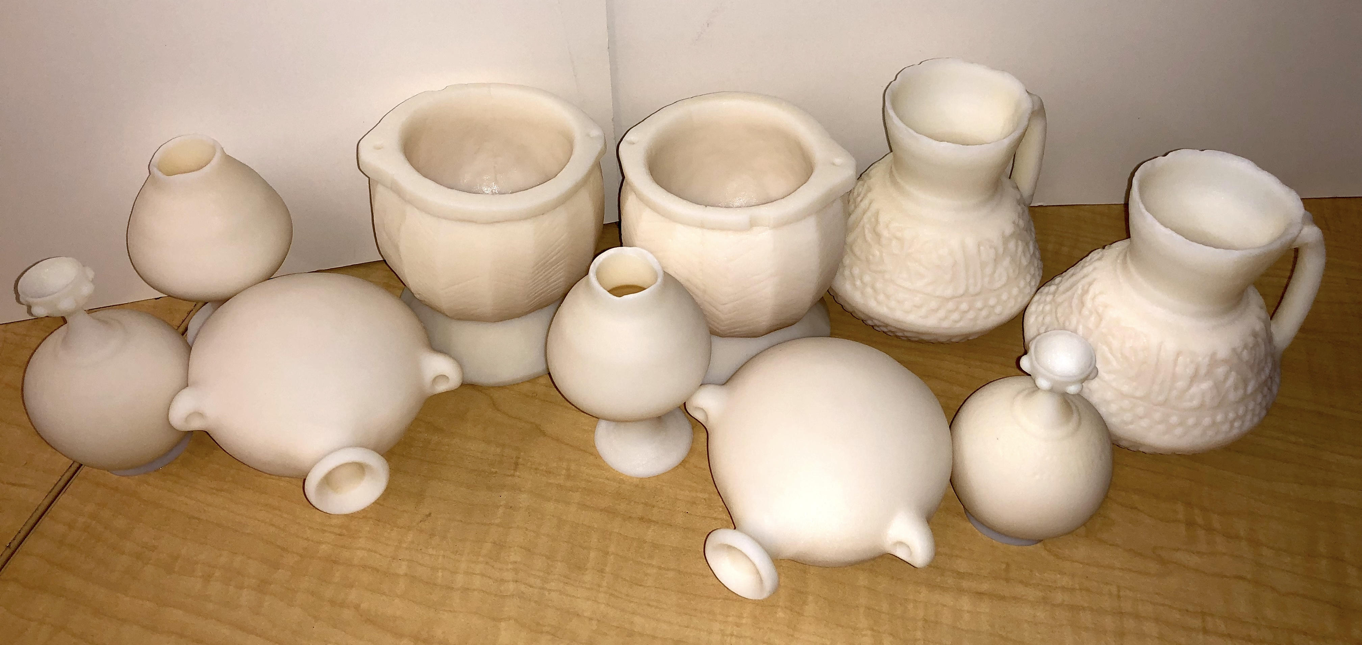
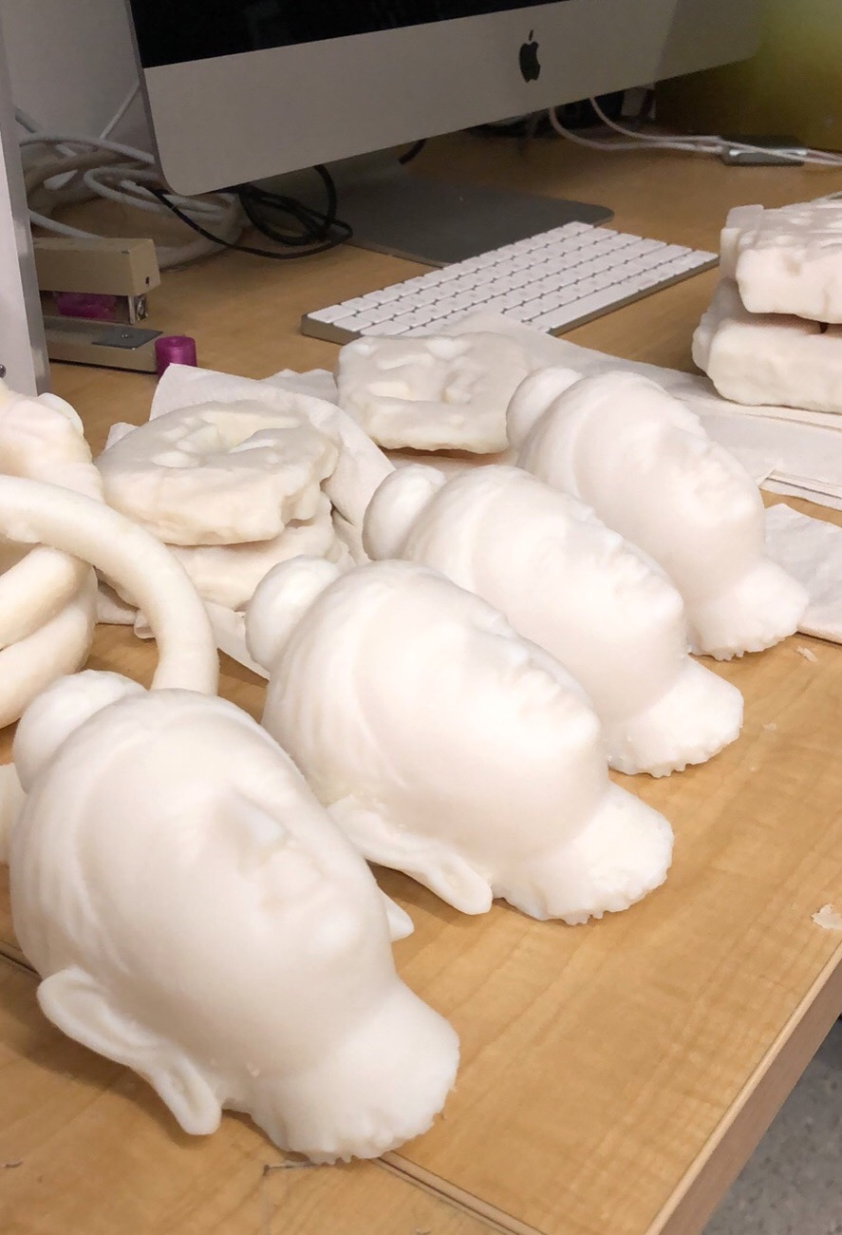
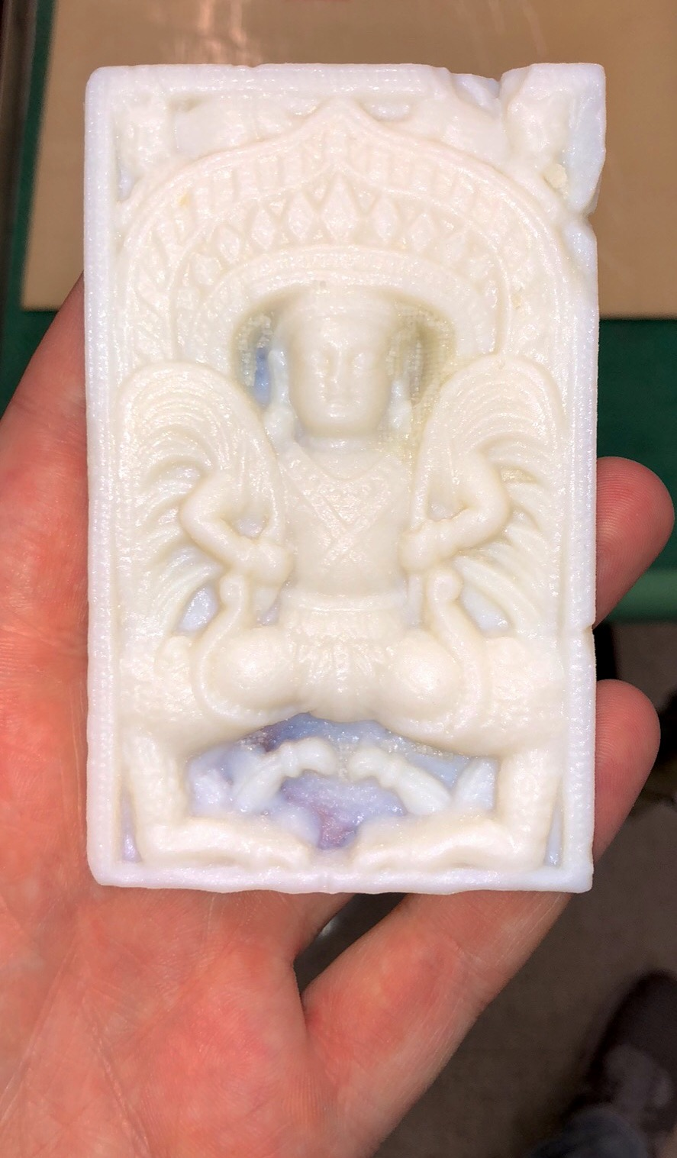
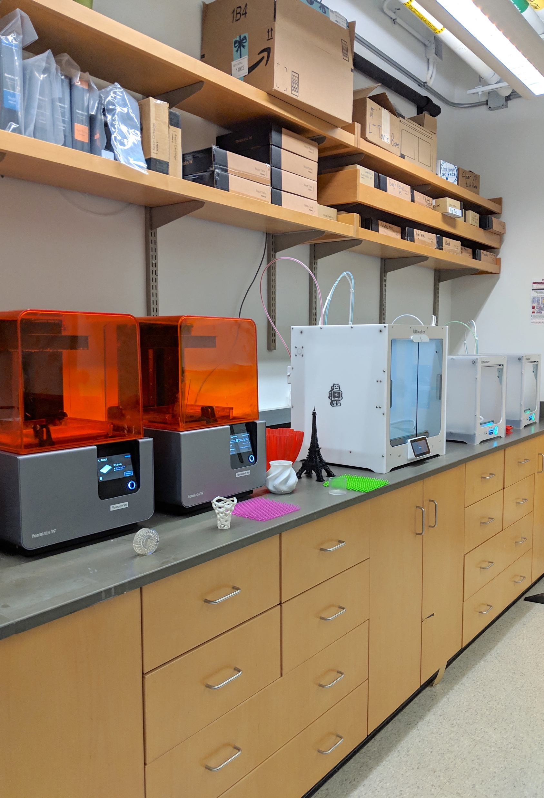
Oriental Institute Mobile Museum Project
DMR-MRSEC 1420709
2019
University of Chicago: Education, Diversity & Outreach
We pursued new outreach directions with campus museums including the Smart Museum of Art and the Oriental Institute. In partnership with the Oriental Institute and the National Museum of Afghanistan, we used our 3D printer labs to develop educational kits of 3D printed artifacts of culturally significant museum artifacts for the Mobile Museum Outreach Project. These kits will be used to raise awareness of cultural preservation and modern conservation technologies, such as 3D printing, at twenty-four schools, five Lincoln Learning Centers, and two orphanages in Afghanistan.
Figure: Selection of 3D printed artifacts clockwise from top: flasks & pottery; 3D printer lab; ivory plaque; Buddha heads

