Slide 1
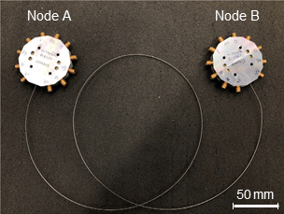
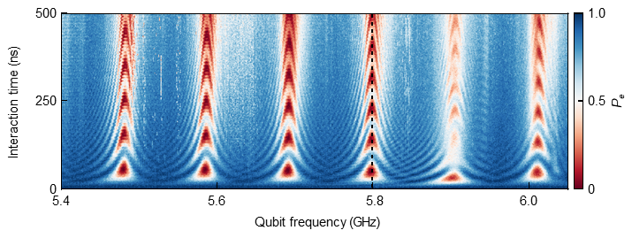
Multi-qubit Entanglement in a Quantum Network
DMR-MRSEC 2011854
2020
Univ. of Chicago MRSEC: SUPER-SEED
Cleland and Schuster demonstrated multi-bit entanglement in a Quantum Network. (left) Photograph of the quantum network assembly, where each node is in a machined-aluminium sample holder connected internally to the superconducting cable. (right) Vacuum Rabi oscillations within the six standing modes in the coaxial cable. Plotted is the interaction time as a function of the Qubit Frequency. Zhong Y. et. al. Nature (2021)

