Slide 1
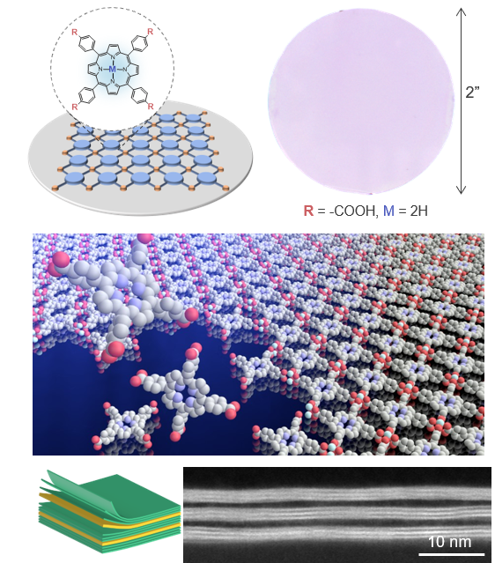
Wafer-scale synthesis of monolayer two-dimensional porphyrin polymers
DMR-MRSEC 1420709
2020
Univ. of Chicago MRSEC Superseed1:
At the University of Chicago MRSEC, Park and Sibener developed a synthesis of two-dimensional (2D) polymers with wafer-scale homogeneity, one monolayer thick, using a general and scalable growth method called laminar assembly polymerization. The lattice structures and optical properties of these freestanding crystalline films are directly controlled by altering the molecular monomers and polymerization chemistries. Because these 2D polymers are fully compatible with existing large-scale patterning and integration methods, a new powerful approach for interface engineering between dissimilar 2D building blocks has been identified. To demonstrate this, we successfully produced arrays of hybrid heterostructures and superlattices built layer by layer using 2D polymers and 2D atomic crystals based on MoS₂.
Figure 1. (top) Crystal structure of representative 2DPs based on porphyrin building blocks and an optical image of 2” monolayer 2DP film. (middle) An artist’s rendering of the 2DP synthesis (bottom) Cross-sectional ADF STEM image of a vertical superlattice made with MoS₂ (bright lines) and 2DP (dark lines).
Zhong et al., “Wafer-scale synthesis of monolayer two-dimensional porphyrin polymers for hybrid superlattices,” Science , 366, 6471, 1379-1384 (2019). doi: 10.1126/science.aax9385

