Slide 1
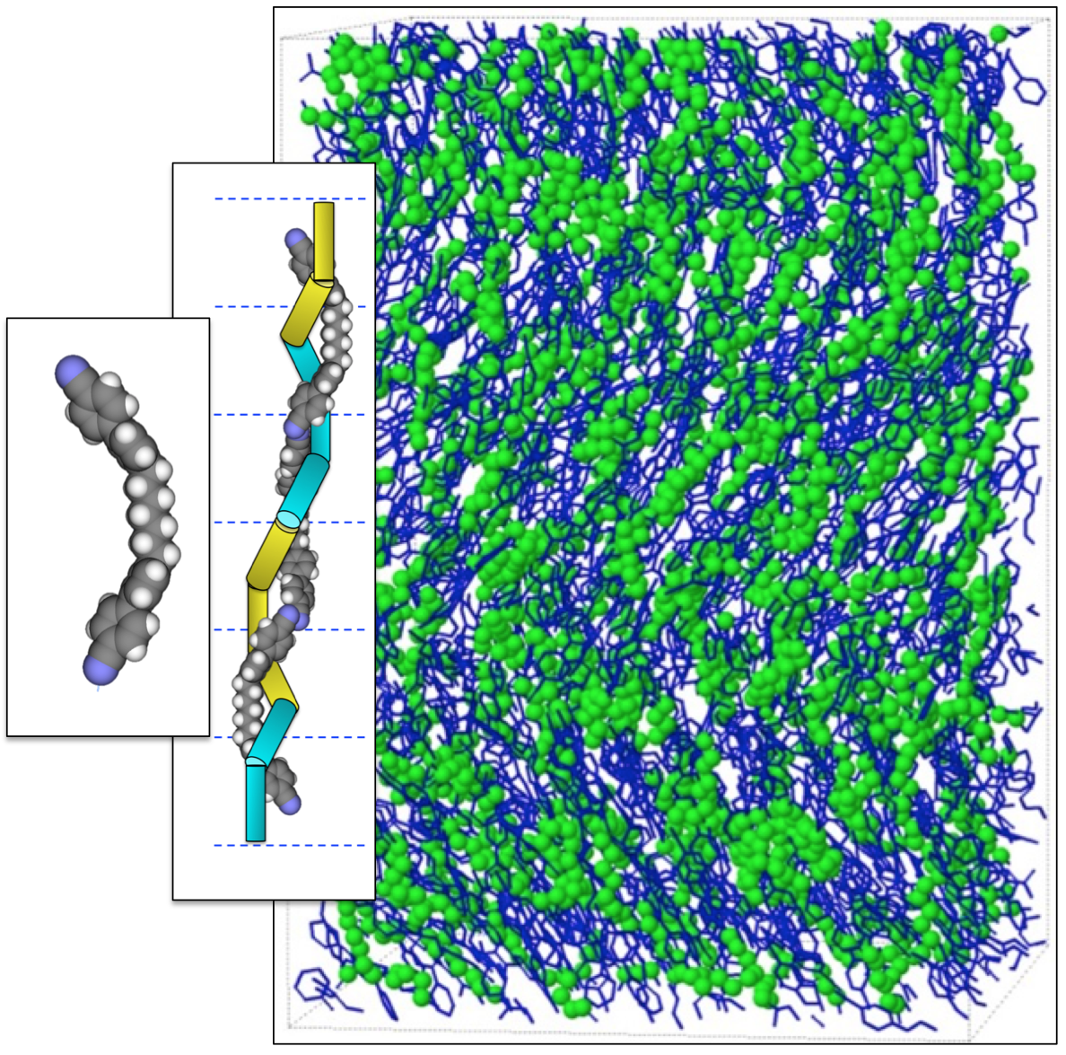
A Double Helix of Bent Molecular Dimers
University of Colorado MRSEC
DMR-1420736
2018
Bedrov, Glaser, Clark, Walba, Maclennan, Radzihovsky
- University of Colorado Boulder
Simple bent molecules like CB7CB shown in the image perform some seemingly miraculous tricks when packed together to make a liquid. Because the molecular ends and middles attract each other, the molecules spontaneously knit themselves together into double stranded chains many units long, like the twisted rope in the graphic. Although the chains are transient, constantly dissolving and reforming, they sense each other's presence and perform a collective dance in which they all adopt the same helical twist. Dynamic simulations, which can carry out the dance at the molecular level on a computer, show the molecules in action, the image capturing the instantaneous arrangement of about 400 molecules. Images like these reveal the molecular chains forming, packing together, filling space, and cooperatively reforming into a single helical structure having the same handedness everywhere. Understanding such self-assembly is key to creating new applications for soft materials like liquid crystals and polymers.
This highlight and associated research was supported by NSF through the University of Colorado Materials Research Science and Engineering Center, DMR 1420736.
Notes:
Colorado MRSEC 1420736 IRG-1 Bedrov Molecular Dimers
IRG-1
Reference – “Double-Helical Tiled Chain Structure of the Twist-Bend Liquid Crystal phase in CB7CB” M. R. Tuchband, M. Shuai, K. A. Graber, D. Chen, C. Zhu, L. Radzihovsky, A. Klittnick, L. Foley, A. Scarbrough, J. H. Porada, M. Moran, J. Yelk, D. Bedrov, E. Korblova, D.M. Walba, A. Hexemer, J. E. Maclennan, M. A. Glaser, N. A. Clark, arXiv preprint arXiv:1703.10787.
M. R. Tuchband¹, M. Shuai¹, K. A. Graber¹, D. Chen⁵, C. Zhu³, L. Radzihovsky¹, A. Klittnick¹, L. Foley¹, A. Scarbrough¹, J. H. Porada⁶, M. Moran⁷, J. Yelk¹, D. Bedrov⁴, E. Korblova², D.M. Walba², A. Hexemer³, J. E. Maclennan¹, M. A. Glaser¹, N. A. Clark¹
¹. Department of Physics - University of Colorado, Boulder, CO 80309, USA.
². Department of Chemistry and Biochemistry - University of Colorado, Boulder, CO 80309, USA.
³. Lawrence Berkeley National Lab, Berkeley, CA
⁴. Materials Science, University of Utah
⁵. Zhejiang University, Hangzhou, China
⁶. University of Stuttgart, Stuttgart, Germany
⁷. Dartmouth College, Hanover, NH 03755, USA

Slide 2
A Double Helix of Bent Molecular Dimers
University of Colorado MRSEC
DMR-1420736
2018
Bedrov, Glaser, Clark, Walba, Maclennan, Radzihovsky
- University of Colorado Boulder
Broader Impacts – Simple bent molecules like CB7CB shown in the image perform some seemingly miraculous tricks when packed together to make a liquid, spontaneously knitting themselves together into double stranded chains many units long, like the twisted rope in the graphic. Understanding such self-assembly is key to creating new applications for soft materials like liquid crystals and polymers.
This highlight and associated research was supported by NSF through the University of Colorado Materials Research Science and Engineering Center, DMR 1420736.
Notes:
IRG-1
Reference – “Double-Helical Tiled Chain Structure of the Twist-Bend Liquid Crystal phase in CB7CB” M. R. Tuchband, M. Shuai, K. A. Graber, D. Chen, C. Zhu, L. Radzihovsky, A. Klittnick, L. Foley, A. Scarbrough, J. H. Porada, M. Moran, J. Yelk, D. Bedrov, E. Korblova, D.M. Walba, A. Hexemer, J. E. Maclennan, M. A. Glaser, N. A. Clark, arXiv preprint arXiv:1703.10787.
M. R. Tuchband¹, M. Shuai¹, K. A. Graber¹, D. Chen⁵, C. Zhu³, L. Radzihovsky¹, A. Klittnick¹, L. Foley¹, A. Scarbrough¹, J. H. Porada⁶, M. Moran⁷, J. Yelk¹, D. Bedrov⁴, E. Korblova², D.M. Walba², A. Hexemer³, J. E. Maclennan¹, M. A. Glaser¹, N. A. Clark¹
¹. Department of Physics - University of Colorado, Boulder, CO 80309, USA.
². Department of Chemistry and Biochemistry - University of Colorado, Boulder, CO 80309, USA.
³. Lawrence Berkeley National Lab, Berkeley, CA
⁴. Materials Science, University of Utah
⁵. Zhejiang University, Hangzhou, China
⁶. University of Stuttgart, Stuttgart, Germany
⁷. Dartmouth College, Hanover, NH 03755, USA

