Slide 1
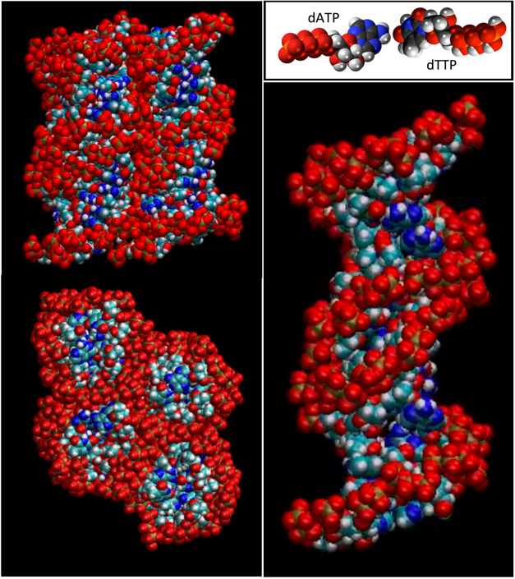
A Double Helix of Nucleic Acid Monomers
University of Colorado MRSEC
DMR-1420736
2018
Clark, Bellini, Glaser- University of Colorado Boulder
The Watson-Crick double helix is a universally fa-miliar pairing of two single strands of polymeric DNA in water. The single strands, each with A, C, G, and T side group bases form a duplex chain when the bases of the two chains match up as A-T and C-G pairs. SMRC researchers have found that NA mon-omer bases such as Adenosine triphosphate (dATP), when mixed solution with the other monomers dCTP, dGTP, or dTTP at sufficiently high concentra-tion and low temperature, can order into a liquid crystal phase of columnar stacks of paired mono-mers. Remarkably, this completely backbone-free state exhibits the key structural elements of polymer-ic biological nucleic acids, including long-ranged columnar helical duplex stacking of base-pairs, com-plementarity-dependent partitioning of molecules, and Watson-Crick selectivity, such that, among all of the mixed solutions of A, C, G, and T triphosphates, duplex columnar ordering is found only in the A-T and C-G combinations. These assemblies of mono-mers, physical associations of the smallest molecules known to self-assemble into the double helix, pro-vide starting states capable of partitioning appropri-ate molecules from solution with a high degree of selectivity, as potential catalytic pathways for the prebiotic appearance of molecular selection and self-assembly and, ultimately, of the sequence-directed assembly of polymers.
This highlight and associated research was supported by NSF through the University of Colorado Materials Research Science and Engineering Center, DMR 1420736.
Notes:
IRG 1
Reference – "BACKBONE-FREE DUPLEX-STACKED MONOMER NUCLEIC ACIDS EXHIBITING WATSON-CRICK SELECTIVITY," G.P. Smith, T.P. Fraccia, M. Todisco, G. Zanchetta, J. Yelk, C. Zhu, E. Hayden, T. Bellini, M.A. Glaser, N.A. Clark, Proceedings of the National Academy of Sciences (2018).
G.P. Smith¹, T.P. Fraccia², M. Todisco², G. Zanchetta², J. Yelk¹, C. Zhu³, E. Hayden¹, T. Bellini², M.A. Glaser¹, N.A. Clark¹
¹. Department of Physics - University of Colorado, Boulder, CO 80309, USA.
². University of Milan, Milan Italy
³. Lawrence Berkeley National Lab, Berkeley, CA

Slide 2
A Double Helix of Nucleic Acid Monomers
University of Colorado MRSEC
DMR-1420736
2018
Clark, Bellini, Glaser- University of Colorado Boulder
Broader Impacts - The DNA double helix is a universally familiar pairing of two polymer chains in water, joined into a duplex by the selective binding of side group bases, the sequence of which contains and transmits genetic information.
But researchers in the University of Colorado, Boulder Soft Materials Research Center have found that DNA double helical ordering is also possible without the polymer chains. In the images the single DNA base monomers ATP and TTP are forming double helical stacks in a concentrated solition. The research team spaculates that this may have been key to the origin of life: the way that DNA-like molecules first appeared in the prebiotic universe.
This highlight and associated research was supported by NSF through the University of Colorado Materials Research Science and Engineering Center, DMR 1420736.
Notes:
Reference – "BACKBONE-FREE DUPLEX-STACKED MONOMER NUCLEIC ACIDS EXHIBITING WATSON-CRICK SELECTIVITY," G.P. Smith, T.P. Fraccia, M. Todisco, G. Zanchetta, J. Yelk, C. Zhu, E. Hayden, T. Bellini, M.A. Glaser, N.A. Clark, Proceedings of the National Academy of Sciences (2018).
G.P. Smith¹, T.P. Fraccia², M. Todisco², G. Zanchetta², J. Yelk¹, C. Zhu³, E. Hayden¹, T. Bellini², M.A. Glaser¹, N.A. Clark¹
¹. Department of Physics - University of Colorado, Boulder, CO 80309, USA.
². University of Milan, Milan Italy
³. Lawrence Berkeley National Lab, Berkeley, CA

