Slide 1
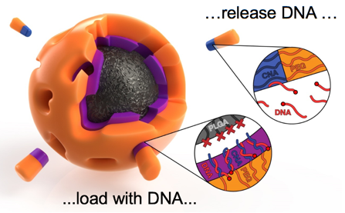
Nanoparticles For Delivery of DNA Therapeutics
University of Colorado MRSEC
DMR-1420736
2018
Cha, Domaille, Bowman, Fairbanks –
University of Colorado Boulder
Many advanced drugs acting in cells are made of DNA fragments. Since DNA is biologically active and destroyed if not recognized, a major challenge for this kind of medicine is getting the DNA into selected target cells. SMRC researchers have found that soap-like molecules that form nanometer-size spherical particles in water and that have a DNA-like click nucleic acid component as part of their molecular structure can act as effective carriers of the therapeutic DNA.
This highlight and associated research was supported by NSF through the University of Colorado Materials Research Science and Engineering Center, DMR 1420736.
Notes:
IRG-2
Reference – "SYNTHESIS AND ASSEMBLY OF CLICK-NUCLEIC-ACID-CONTAINING PEG-PLGA NANOPARTICLES FOR DNA DELIVERY," A. Harguindey, D.W. Domaille, B.D. Fairbanks, J. Wagner, C.N. Bowman, J.N. Cha, Advanced Materials 29, (24) (2017). DOI: 10.1002/adma.201700743
A. Harguindey¹, D.W. Domaille¹, B.D. Fairbanks¹, J. Wagner¹, C.N. Bowman^{1,2}, J.N. Cha^{1,2}
1 Chemical and Biological Engineering - University of Colorado, Boulder, CO 80309, USA.
2 Materials Science and Engineering Program - University of Colorado, Boulder, CO 80309, USA.

Slide 2
Nanoparticles For Delivery of DNA Theraputics
University of Colorado MRSEC
DMR-1420736
2018
Cha, Domaille, Bowman, Fairbanks –
University of Colorado Boulder
Broader Impacts – Many advanced drugs acting in cells are made of DNA fragments. Since DNA is biologically active and destroyed if not recognized, a major challenge for this kind of medicine is getting the DNA into selected target cells. SMRC researchers have found that soap-like molecules that form nanometer-size spherical particles in water and that have a DNA-like component as part of their molecular structure can act as effective carriers of therapeutic DNA for cancer treatment.
This highlight and associated research was supported by NSF through the University of Colorado Materials Research Science and Engineering Center, DMR 1420736.
Notes:
IRG-2
Reference – "SYNTHESIS AND ASSEMBLY OF CLICK-NUCLEIC-ACID-CONTAINING PEG-PLGA NANOPARTICLES FOR DNA DELIVERY," A. Harguindey, D.W. Domaille, B.D. Fairbanks, J. Wagner, C.N. Bowman, J.N. Cha, Advanced Materials 29, (24) (2017). DOI: 10.1002/adma.201700743
A. Harguindey¹, D.W. Domaille¹, B.D. Fairbanks¹, J. Wagner¹, C.N. Bowman^{1,2}, J.N. Cha^{1,2}
1 Chemical and Biological Engineering - University of Colorado, Boulder, CO 80309, USA.
2 Materials Science and Engineering Program - University of Colorado, Boulder, CO 80309, USA.

