Slide 1
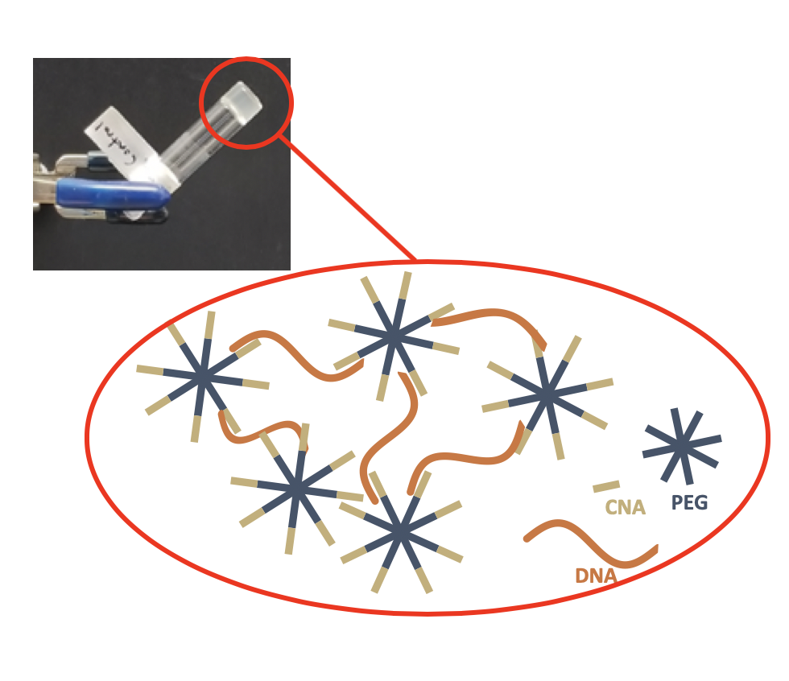
Hydrogels from DNA mimicking polymers and DNA
University of Colorado MRSEC
DMR-1420736
2019
Bowman- University of Colorado Boulder
Radical, light initiated chemical reactions were used to synthesize multifunctional, star-shaped polmyers with each chain end bound to a DNA mimicking polymer (the “Click Nucleic Acid or CNA developed with the support of the NSF). When combined with single stranded DNA with a complementary bases, these star-polymers arrange in a network that is held together by noncovalent attractions. Analysis of these materials shows that they degel or “melt” at higher temperatures and reform when cooled down.
This highlight and associated research was supported by NSF through the University of Colorado Materials Research Science and Engineering Center, DMR 1420736.
Figure. Hybrid hydrogels formed by the noncovalent interactions of native DNA with synthetic CNA-terminated star-shaped polymers. The DNA acts as crosslinkers that reversibly hold the synthetic polymers in a network with properties similar to many biological tissues.
Notes:
Senior Investigators –Bowman, Fairbanks, Bryant, He, Domaille, Cha
Reference – "NEW GENERATION OF CLICKABLE NUCLEIC ACIDS: SYNTHESIS AND ACTIVE HYBRIDIZATION WITH DNA", X. Han, D.W. Domaille, B.D. Fairbanks, L. He, H.R. Colver, X. Zhang, J.N. Cha, C.N. Bowman, Biomacromolecules, 19, 4139-4146 (2018). DOI: 10.1021/acs.biomac.8b01164
X. Han¹, D.W. Domaille¹, B.D. Fairbanks¹, L. He¹, H.R. Colver¹, X. Zhang¹, J.N. Cha¹, C.N. Bowman¹
¹ Department of Chemical and Biological Engineering, University of Colorado, Boulder, CO 80309, USA.

Slide 2
Hydrogels from DNA mimicking polymers and DNA
University of Colorado MRSEC
DMR-1420736
2019
Bowman - University of Colorado Boulder
The development of dynamic hydrogels is a highly sought after goal in the field of tissue engineering and biomaterials. Often, covalent hydrogels that can degrade are used to study and culture cells in an environment that resembles their native tissues. As these gels degrade, however, they lose structural integrity, disintegrating and become no longer suitable for the cells. Gels held together with non-covalent interactions can rearrange their polymer chains to accommodate the cells’ movement without losing the advantageous mechanical properties.
Figure. Hybrid hydrogels formed by the noncovalent interactions of native DNA with synthetic CNA-terminated star-shaped polymers. The DNA acts as crosslinkers that reversibly hold the synthetic polymers in a network with properties similar to many biological tissues.

