Slide 1
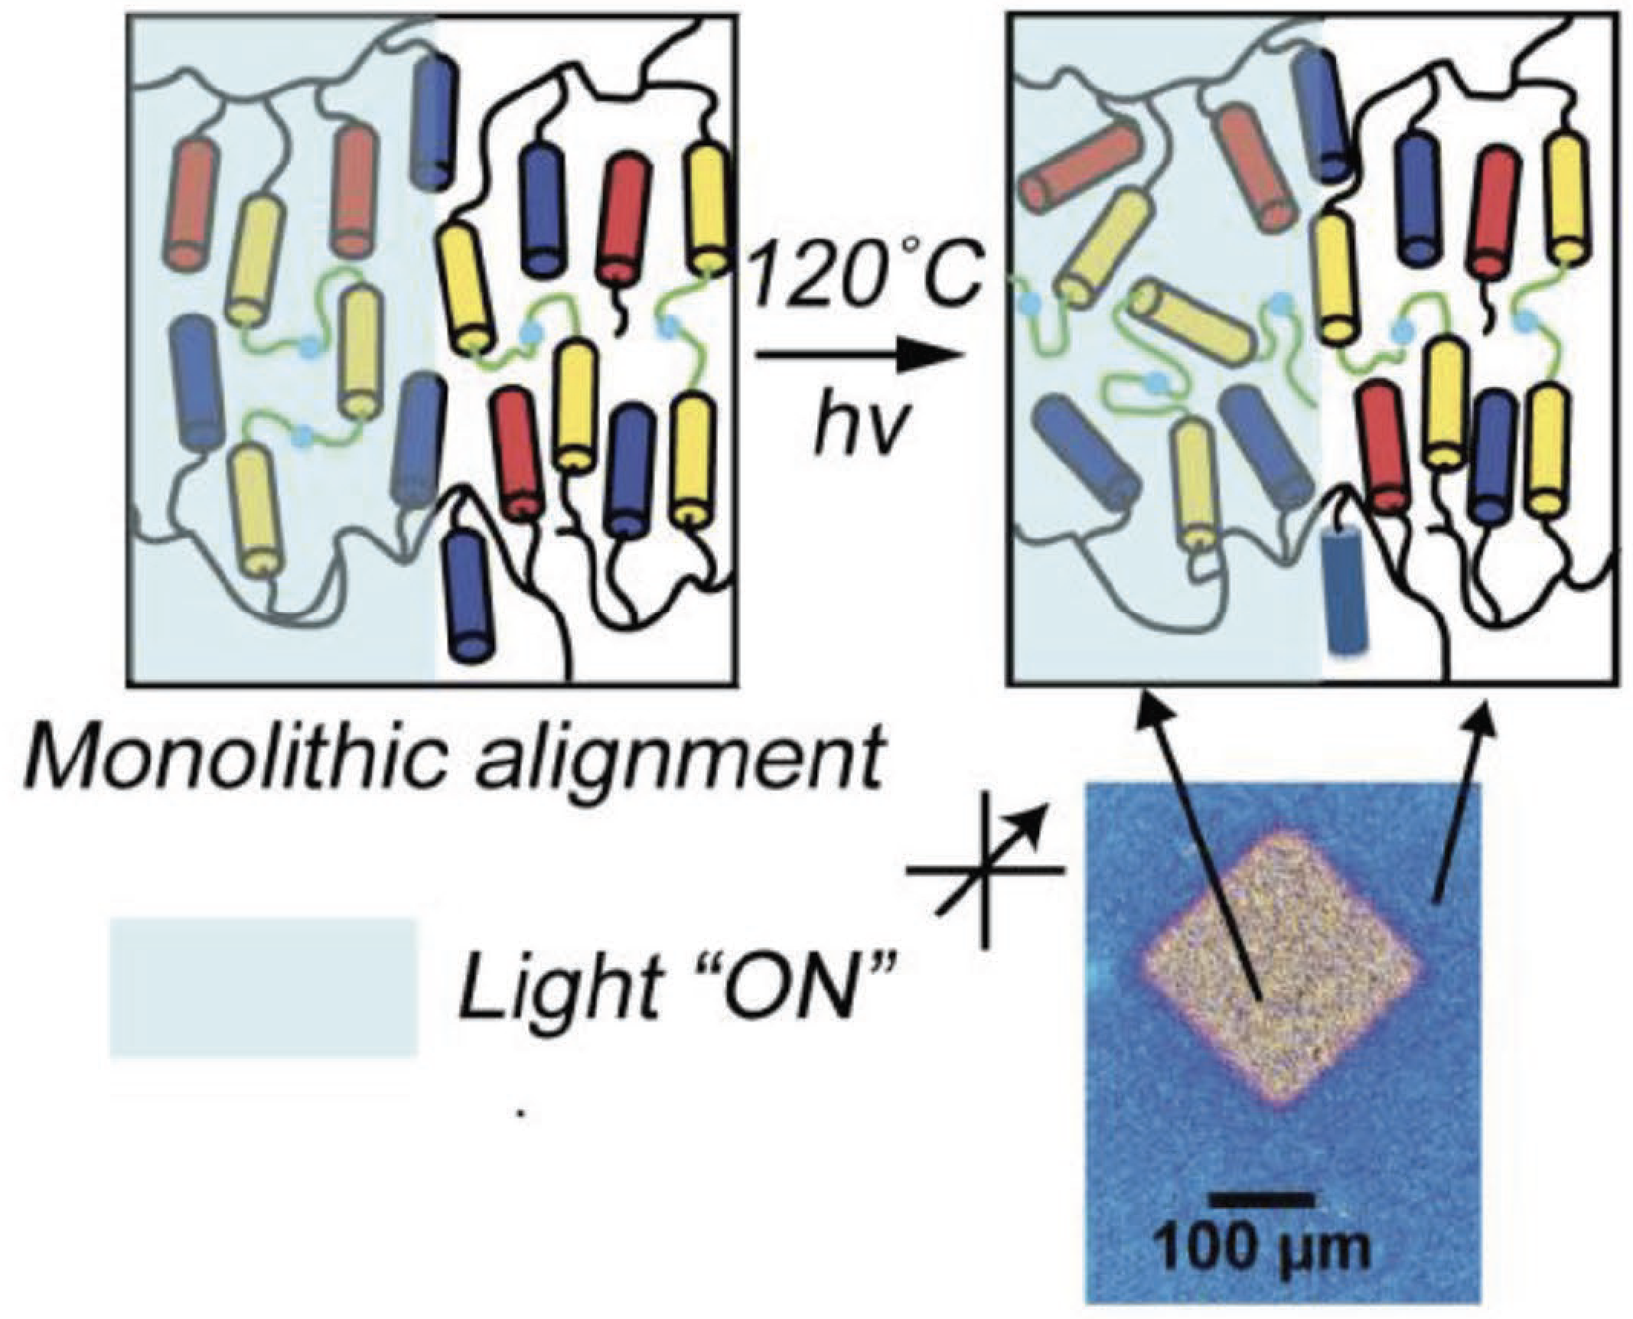
Photoinduced Plasticity In Cross-linked Polymer Networks
MRSEC DMR1420736
2017
Christopher Bowman, University of Colorado Boulder
Molecules in the form of extended chains (polymers) make liquids or glasses, depending on the chain flexibility. Connecting flexible chains together with chemical crosslinks can turn a polymer liquid into a rubbery or solid material having a fixed shape. Researchers in the Soft Materials Research Center of the University of Colorado Boulder have employed dynamic covalent chemistry to make cross-links that can be controlled optically, enabling materials that can be softened or changed in shape by light.
"PHOTOINDUCED PLASTICITY IN CROSS-LINKED LIQUID CRYSTALLINE NETWORKS", M.K. McBride, M. Hendrikx, D.Q. Liu, B.T. Worrell, D.J. Broer, C.N. Bowman, Advanced Materials, 29 (2017). DOI: 10.1002/ADMA.201606509

