Slide 1
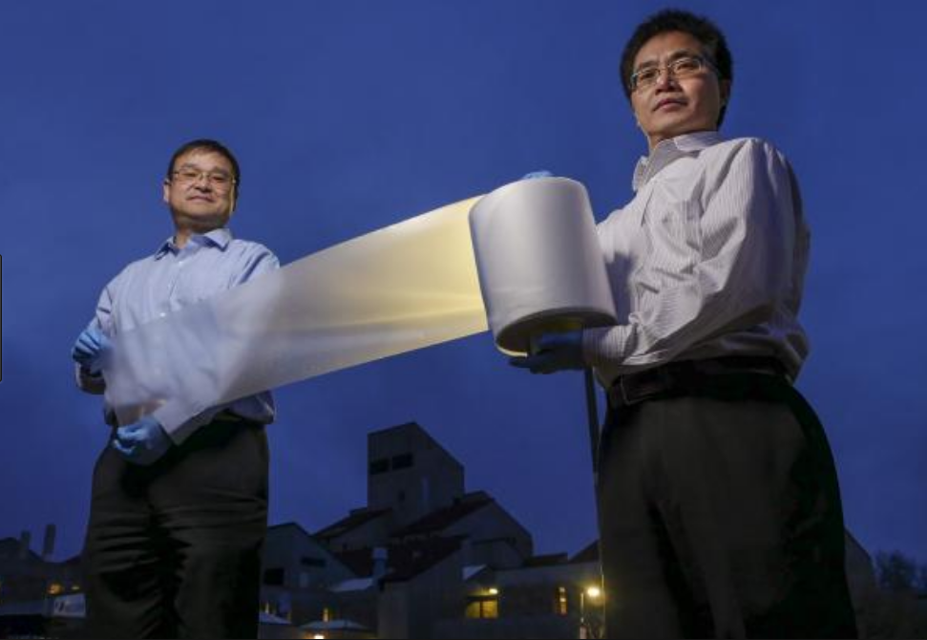
Inexpensive Polymer Films for Efficient Daytime Radiative Cooling
MRSEC DMR1420736
2017
Xiaobo Yin & Ronggui Yang, University of Colorado Boulder
On clear nights the landscape cools by radiating light into space. This light is infrared, in the 7 micron to 14 micron wavelength range, where the Earth’s atmosphere is transparent. Starting from a Seed Grant from the Soft Materials Research Center of the University of Colorado, Boulder, Xiaobo Yin and colla-borator Ronggui Yang have discovered a design theme for making inexpensive polymer films, like the one in the image, that are transparent in the visible range but, because they are loaded with micron-size glass spheres, approach having the maximum efficiency for infrared radiation into space. These films are capable of cooling themselves even in direct sunlight, with a demonstrated daylight emissivity of about 100 W/m². This discovery shows great promise as an inexpensive way to eliminate waste heat in buildings, cooling systems, and even cars and trucks.
“SCALABLE-MANUFACTURED RANDOMIZED GLASS-POLYMER HYBRID METAMATERIAL FOR DAYTIME RADIATIVE COOLING," Y. Zhai, Y.G. Ma, S.N. David, D.L. Zhao, R.N. Lou, G. Tan, R.G. Yang, X.B. Yin, Science 355, (2017). DOI: 10.1126/science.aai7899

