Slide 1
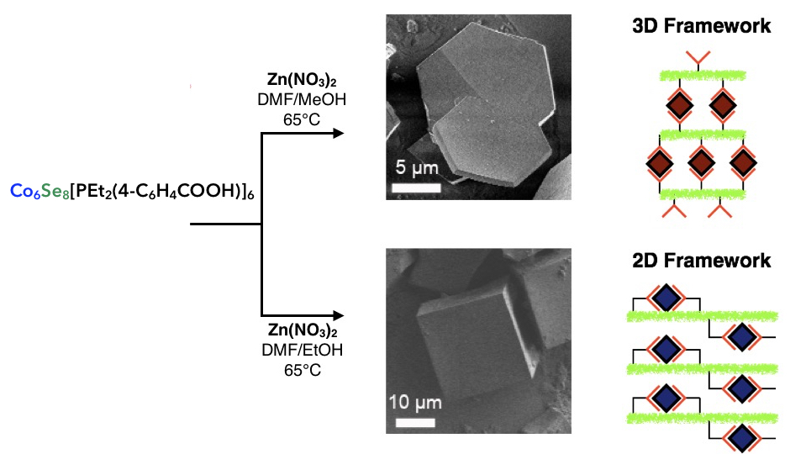
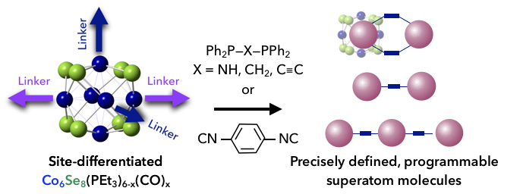
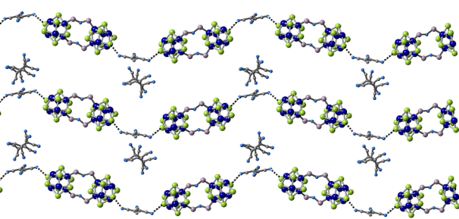
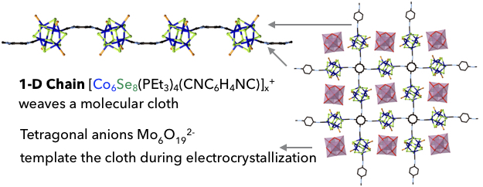
Programming Dimensionality in Superatomic Materials
MRSEC: DMR-1420643
2017
Colin Nuckolls, Columbia University Center for Precision Assembly of Superstratic and Superatomic Solids
The synthesis of site-differentiated Co₆Se₈(PEt₃)_{6-x}(CO)_{x} superatom building blocks (Fig. 1, Ref. 1) has facilitated the assembly and study of superatom, nano-molecules of precise arrangements and size. Precise extended nano-materials were assembled from these superatom building blocks using donor-acceptor interactions (Fig. 2), hydrogen bonding (Fig. 3) and, remarkably, covalent bonding (Fig. 4). The bulk properties (such as magnetism and conductivity) of the assembled materials are determined by the composition and dimensionality of the assembly.
Featured as one of the “Ten Ideas That Will Change the World” in Scientific American in 2016, the discovery featured in Ref. 1 of assembling site-differentiated, atomically precise clusters into dimensionally controlled materials opens a new way to design and program a next generation of functional nanomaterials.
Fig. 1 Assembly of Superatom Molecules From Site-Differentiated Co₆Se₈ Superatom Building Blocks.
Fig. 3 Hydrogen Bonding to Template the Assembly of a Superatom MOF.
Fig. 2 Donor-Acceptor Interactions: 1-D Chains in Charge-Transfer Salts {Co₆Se₈(PEt₃)₄[(PPh₂)₂NH] ₂}[TCNE] ₂.
Fig. 4 Covalently Bonded Superatom Chains Weave a Molecular Cloth.
Reference 1: Champsaur, A. M.; Velian, A.; Paley, D. W.; Choi, B.; Roy, X.; Steigerwald, M. L.; Nuckolls, C. Nano Lett. 2016, 16, 5273–5277

