Slide 1
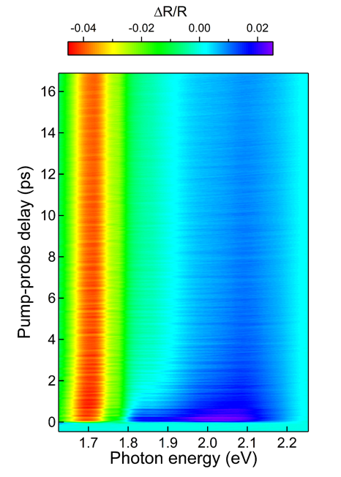
Hierarchical Coherent Phonons in 2D Superatomic Semiconductor
MRSEC: DMR-1420634
2019
Xiaoyang Zhu, Xavier Roy, Colin Nuckolls, Center for Precision Assembly of Superstratic and Superatomic Solids
The coupling of phonons to electrons, excitons and other phonons plays a defining role in material properties, including charge and energy transport, light emission, and superconductivity. In atomic solids such as Si or GaAs, phonons are delocalized over the three-dimensional (3D) lattice and are determined by bonding and crystal symmetry. In molecular materials, by contrast, localized molecular vibrations couple to electrons to produce, for example, high temperature superconductivity, as in A₃C₆₀. Here we describe a hierarchical semiconductor that expands the phonon space by combining localized 0D phonon modes with delocalized phonon manifolds. The structure of this material consists of superatomic building blocks (Re₆Se₈) covalently linked into 2D sheets that are stacked into a layered van der Waals lattice. Using transient reflectance spectroscopy and theoretical calculations, we identify three different types of coherent phonons produced by optical excitation: localized 0D breathing modes of isolated superatom, 2D synchronized twisting of superatoms in layers, and 3D acoustic interlayer deformation. We show that these phonons are coupled to the electronic degrees of freedom to varying extents. The presence of local phonon modes in an extended crystal opens the door to controlling material properties from hierarchical phonon engineering.
Fig. 1. The 0-3D hierarchical phonons in the layered superatomic semiconductor, Re₆Se₈Cl₂. SBM – symmetric breathing mode; ABM – assymetric breathing mode; CTM – cluster twisting mode; LA – longitudinal acoustic mode.
Fig. 2. Transient reflectance spectrum of Re₆Se₈Cl₂. Pumped at the bandgap with 1.55 eV, 40 fs pulses and probed with a supercontinuum white light. The 2D inter-superatom twisting modes is enhanced for probe near the bandgap due to strong e-ph coupling, while the higher frequency 0D mode of each superatomc is insensitive to probe photon energy.
References:
Kihong Lee, Sebastian F. Maehrlein, Xinjue Zhong, Bonnie Choi, Daniele Meggiolaro, Filippo De Angelis, Xavier Roy, X.-Y, Zhu, “Hierarchical Phonons in a Superatomic Semiconductor,” submitted.
Xinjue Zhong, Kihong Lee, Bonnie Choi, Daniele Meggiolaro, Fang Liu, Abhay Pasupathy, Filippo De Angelis, Patrick Batail, Xavier Roy, X.-Y. Zhu, “Superatomic Two-Dimensional Semiconductor,” Nano Lett. 2018, 18, 1483-1488

